Slide 1
All In with Arduinos
Jonathan Briggs NCCE 2/26/2019
Chief Technology & Innovation Officer
Eastside Preparatory School [we’re hiring]
Kirkland, WA

Slide 2
Who’s in the room?
What is your interest in being here today?
What is your experience with Arduinos?
What is your comfort with the frustrations of working with hardware?
Who am I?

Slide 3
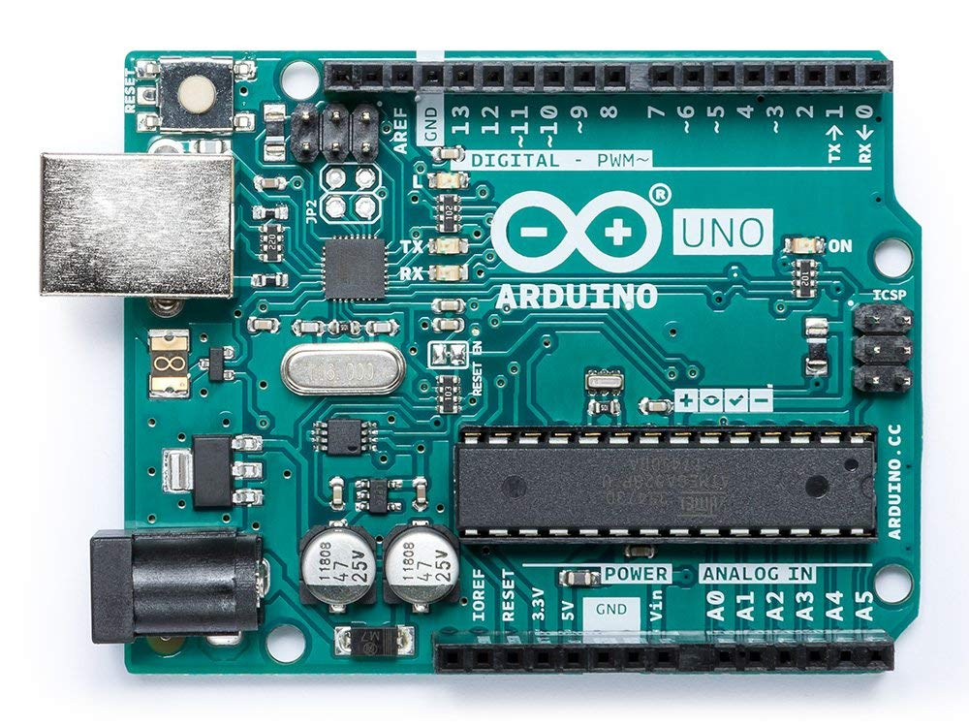
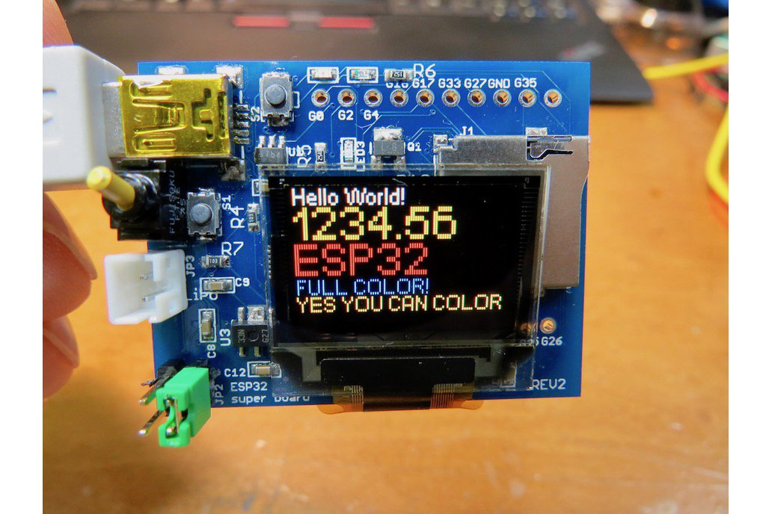
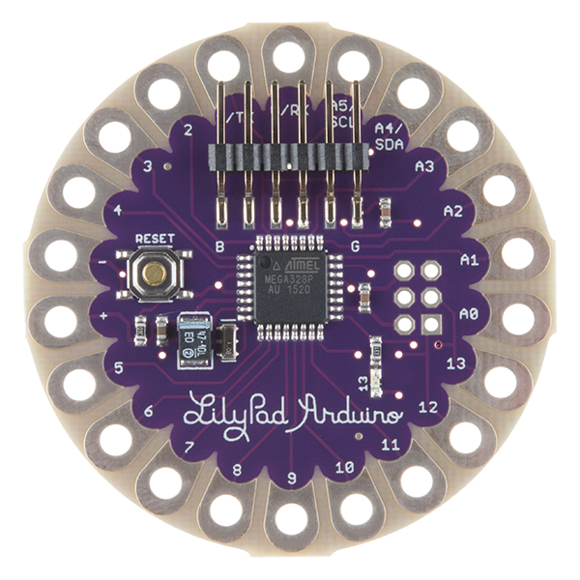
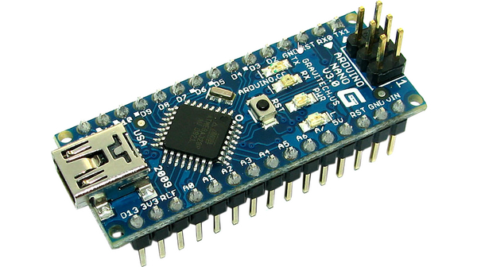
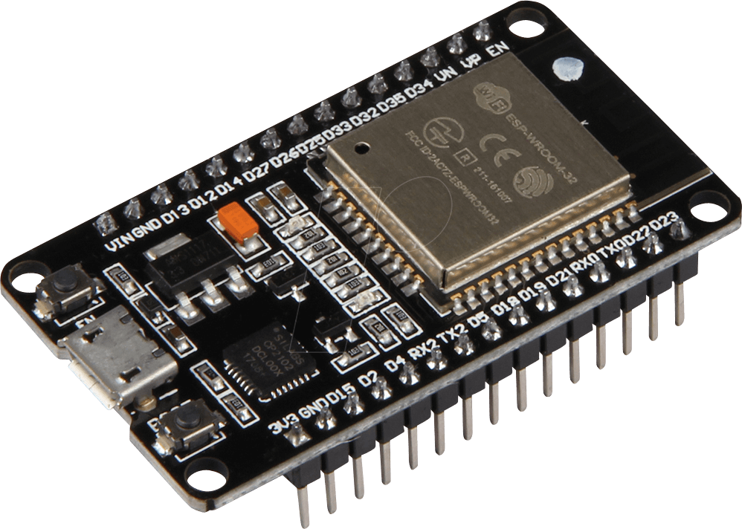
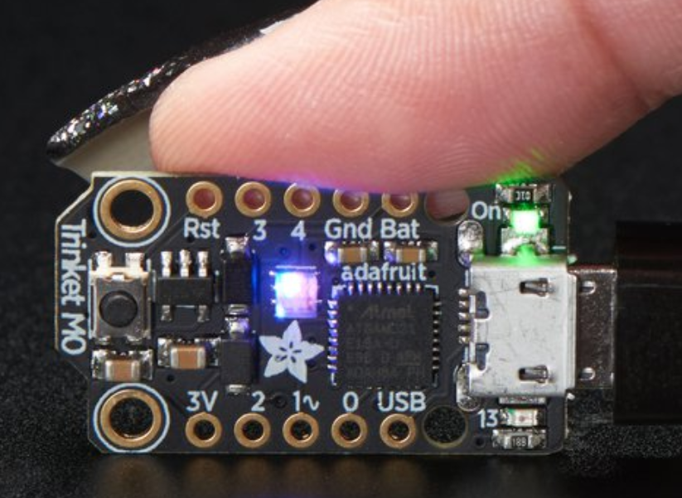
What is an Arduino?
Cheap! $5-$20
Sturdy
Easy to program
Popular, many tutorials

Slide 4
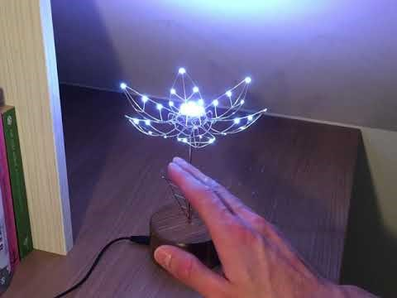
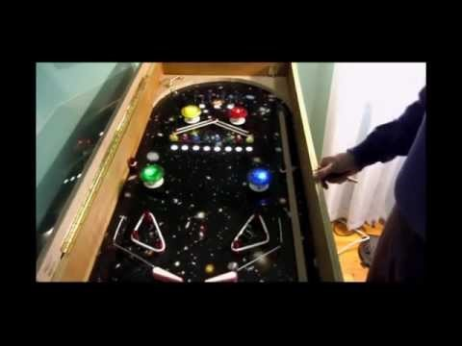
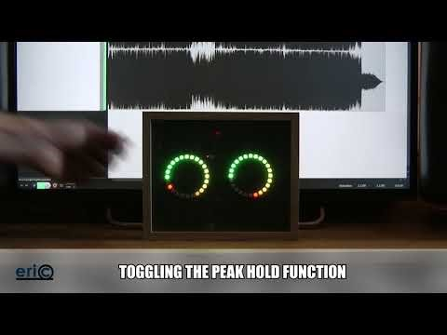

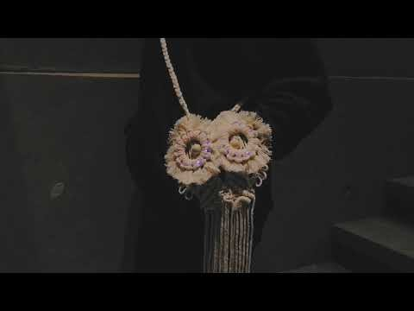
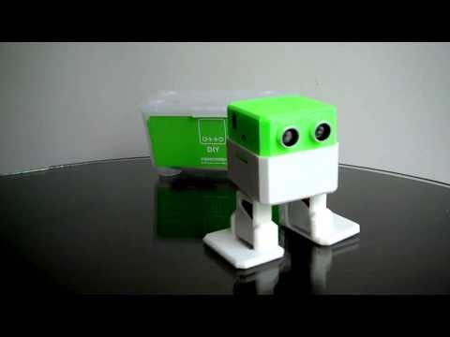
Example Arduino Projects - https://create.arduino.cc/projecthub

Slide 5
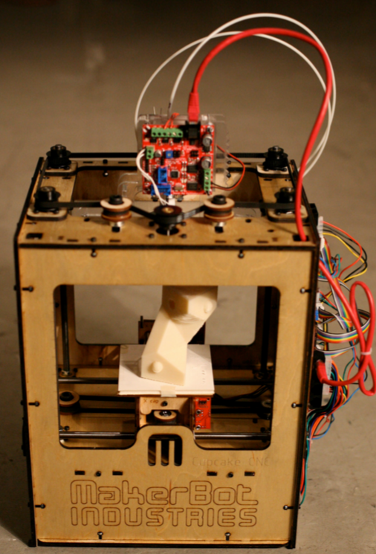
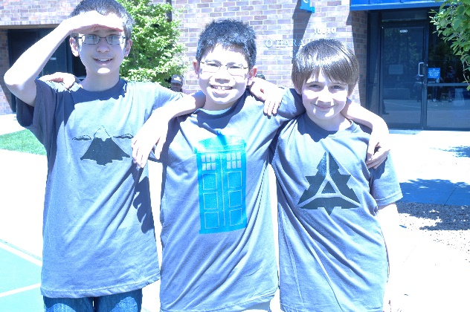
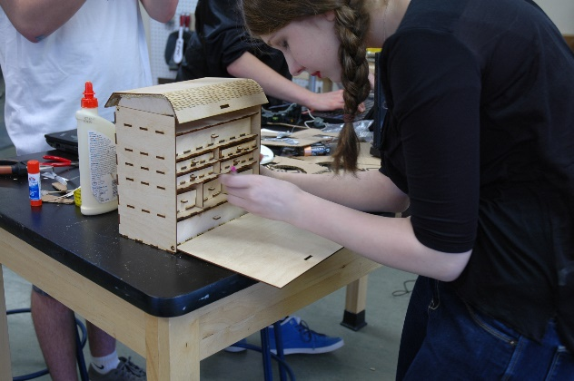
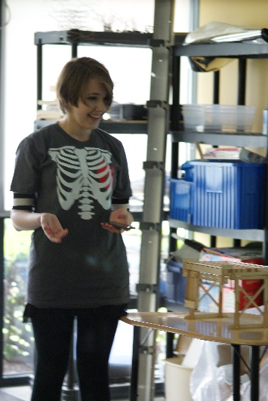
Rewind to 2007 – 2012: Digital Fabrication becomes accessible in schools
Arduinos
3D printers
Laser Cutters
Vinyl Cutters
Eventually we call these places makerspaces…

Slide 6
Getting Traction - 2018
Vinyl cutter – Instant
Laser cutter – one interaction
3D printer – years. Needed tinkerCAD, thingiverse and better printers..
  With initial success, other more advanced CAD is possible
Arduinos / Electronics… many isolated examples… still not there

Slide 7
Why do we care? Aren’ t the other things enough?
The technology department’s mission is to engage and empower students to solve problems with the tools available. This ties into the school’s vision of inspiring students to create a better world.
One of the problems with the world today is that it is hard to understand how it works! There’s too much magic and it must be countered.
  How does your computer get a web page?
  How does your cell phone connect?
  How did the lyft driver get dispatched to your location?
  Why do ads track you around the internet?
  How does Alexa turn on your lights?
  Etc. etc. etc.

Slide 8
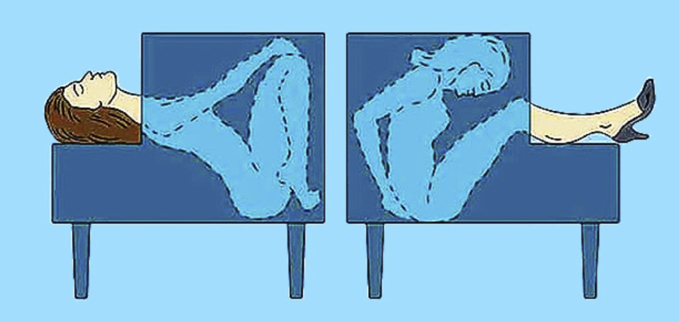
Empowering students starts with demystifying “technology”
Magic is demystified by “knowing the trick.”
  There can still be appreciation of technique, showmanship and embellishments.
For most, the world has been demystified by experience and science.
For technology, we need to build this capacity in our students.
The best way is for them to start making “Magic”

Slide 9
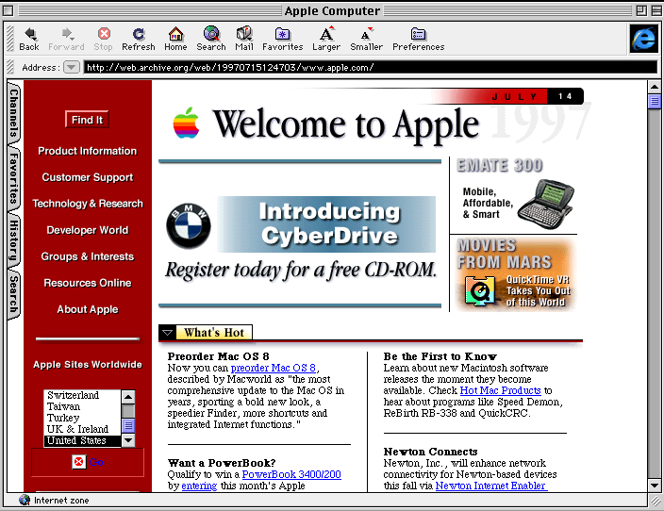
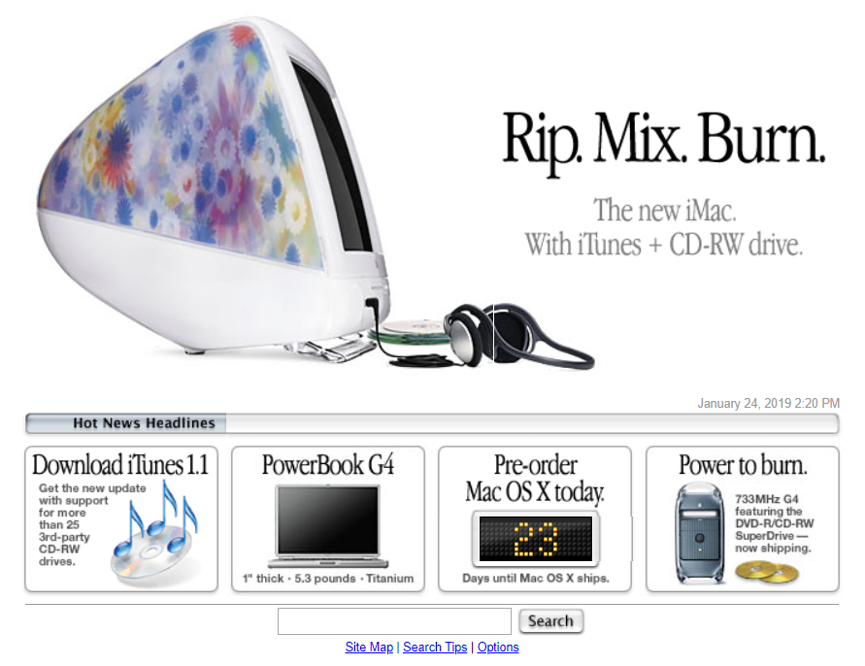
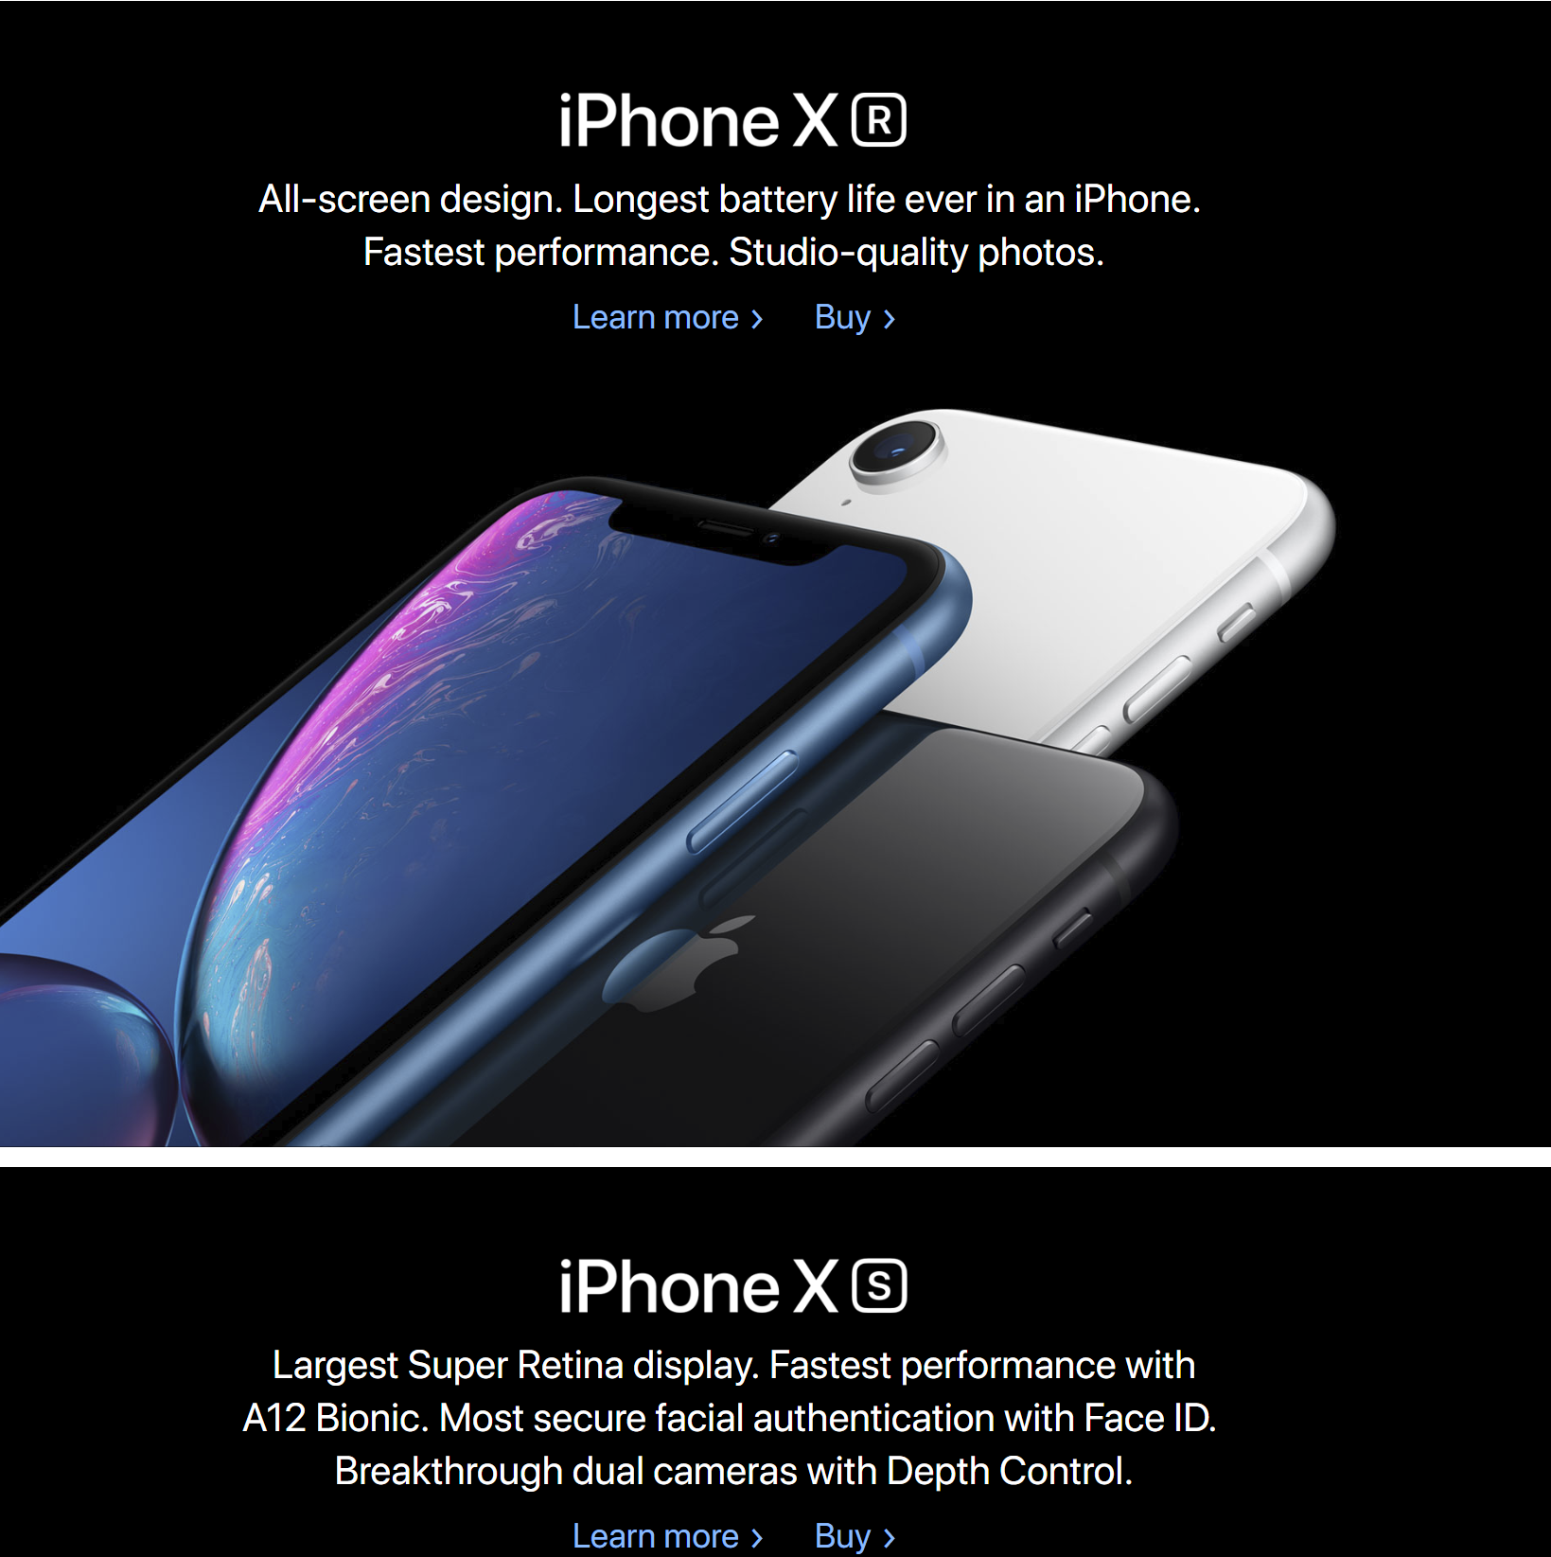

Quick Aside: Teaching anything TECH
Most of what you teach will be wrong soon
Late 1990s Early 2000s Late 2000s Now

Slide 10
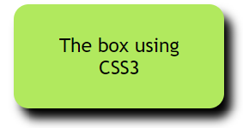

HOW: Rounded Box with Shadow
2000
1) Make an image in photoshop of a rounded box with a shadow
2) Cut that image into 5 separate images, one for each corner, one for the horizontal slice.
3) Use the following HTML and CSS rules, if you want a box wider than your original images or a different color, you have to go back to photoshop to extend your images.
2005 +
Give your content a class
Use CSS rules border-radius and box-shadow
<div class=‘boxed’>Some content</div>
<blockquote class=‘boxed’>Some content</blockquote>
div.boxed {
background-color: #91ea54;
text-align: center;
padding: 20px;
border-radius: 10px;
box-shadow: 5px 7px 10px #000;
}
Blockquote.boxed { max-width: 620px; background: url(rs-right.png) right repeat-y }
Blockquote.boxed:before { display: block; line-height: 0; background: url(rs-topright.png) top right no-repeat; content: url(rs-topleft.png) }
Blockquote.boxed:after { display: block; line-height: 0; background: url(rs-bottomright.png) bottom right no-repeat; content: url(rs-bottomleft.png) }

Slide 11
Idea: Communicate a product to a customer
2000
2005 +
1) Understand the product
2) Empathize with the user
3) Build an experience that matches and stretches the user’s experience. Do they want surprise? Information? To be convinced?
4) Test your design and iterate it
1) Understand the product
2) Empathize with the user
3) Build an experience that matches and stretches the user’s experience. Do they want surprise? Information? To be convinced?
4) Test your design and iterate it

Slide 12
How: To remove an Item from a photo
2000
2016 +
1) Select the Clone Stamp Tool from the toolbar, pick a good sized brush and set the opacity to about 95%
2) Hold alt and click somewhere to take a good sample. ...
3) Release alt and carefully click and drag the mouse over the item you wish to remove. ...
4) Continue to repeat steps 2 and 3 until the unwanted object is completely gone.
--or depending on your background--
1) use the lasso tool to cut irregular shapes out of a background
2) Paste those shapes successively over the shape you want to remove
3) Occassionally lasso new irregular shapes to improve results
Use the lasso tool to select the object you want to delete.
Hit the del key, choose content aware and color adaptation

Slide 13
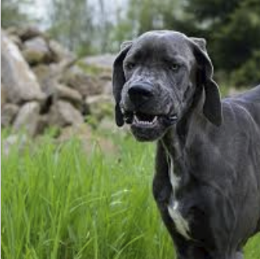
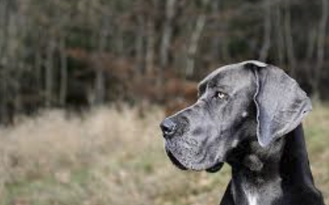
IDEA: What makes a good photo
2000
2016 +
1) Photo tells a story to the viewer
2) Eyes move from subject to subject in an intentional way
3) Cropped to provide focus and composition
4) Good contrast of colors, light, etc.
1) Photo tells a story to the viewer
2) Eyes move from subject to subject in an intentional way
3) Cropped to provide focus and composition
4) Good contrast of colors, light, etc.

Slide 14
Idea: engage and empower students
How*: use arduinos** to demystify tech
* in 2019. In 2025, there may be a better way. **Or other microcontrollers
What will success with Arduinos look like @ Eastside Prep?
  Increased Use
    Used for personal projects
    Used for projects in other classes
  Integrated Integration
    As part of an art piece
    Science sensor
  Increased Understanding
    Of devices around them every day
    Of devices that could potentially be built

Slide 15
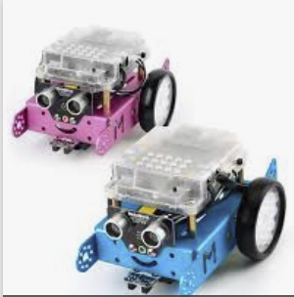
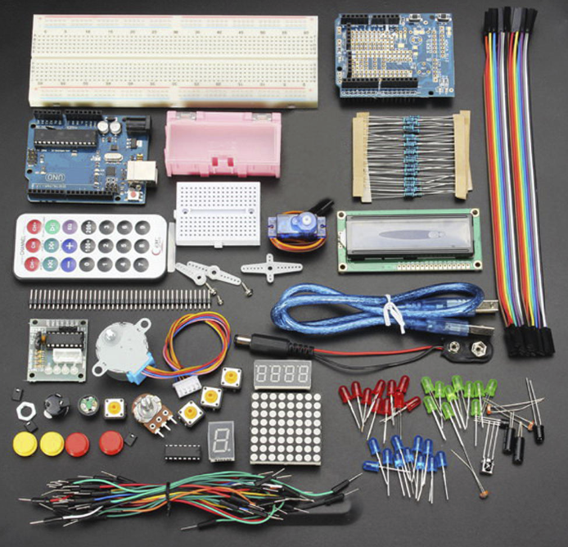
To the HOW: 2019 Version
Problems to solve (Middle School)
  Moving from block coding to text coding…
  First Lego League students in a Mindstorms class
  Available sensors
  Expanding the sense of possible applications
Problems to solve (Upper/High School)
  Understanding electronics
  Quality of projects being produced
  Expanding the sense of possible applications

Slide 16
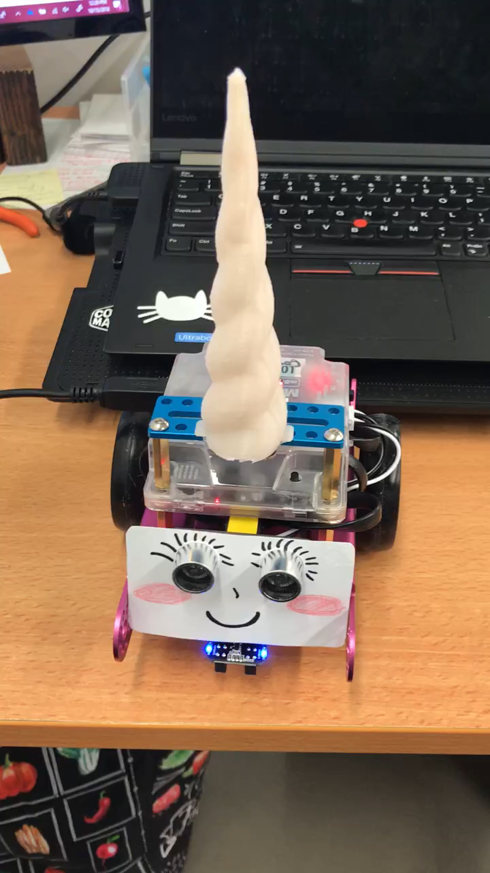
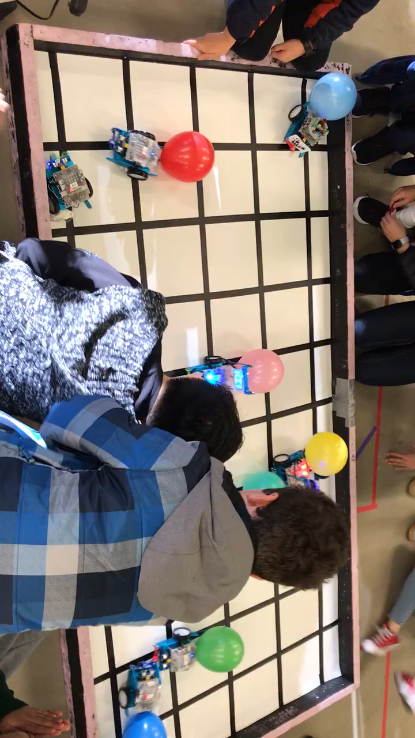
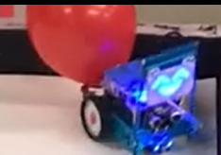
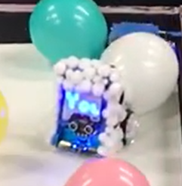
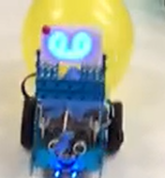
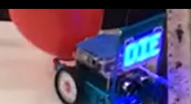
MS BOTZ class - mBot
Arduino platform. mBot software has blocks => text capability
Many of the same Lego challenges can be done
Based on iteration and challenges

Slide 17
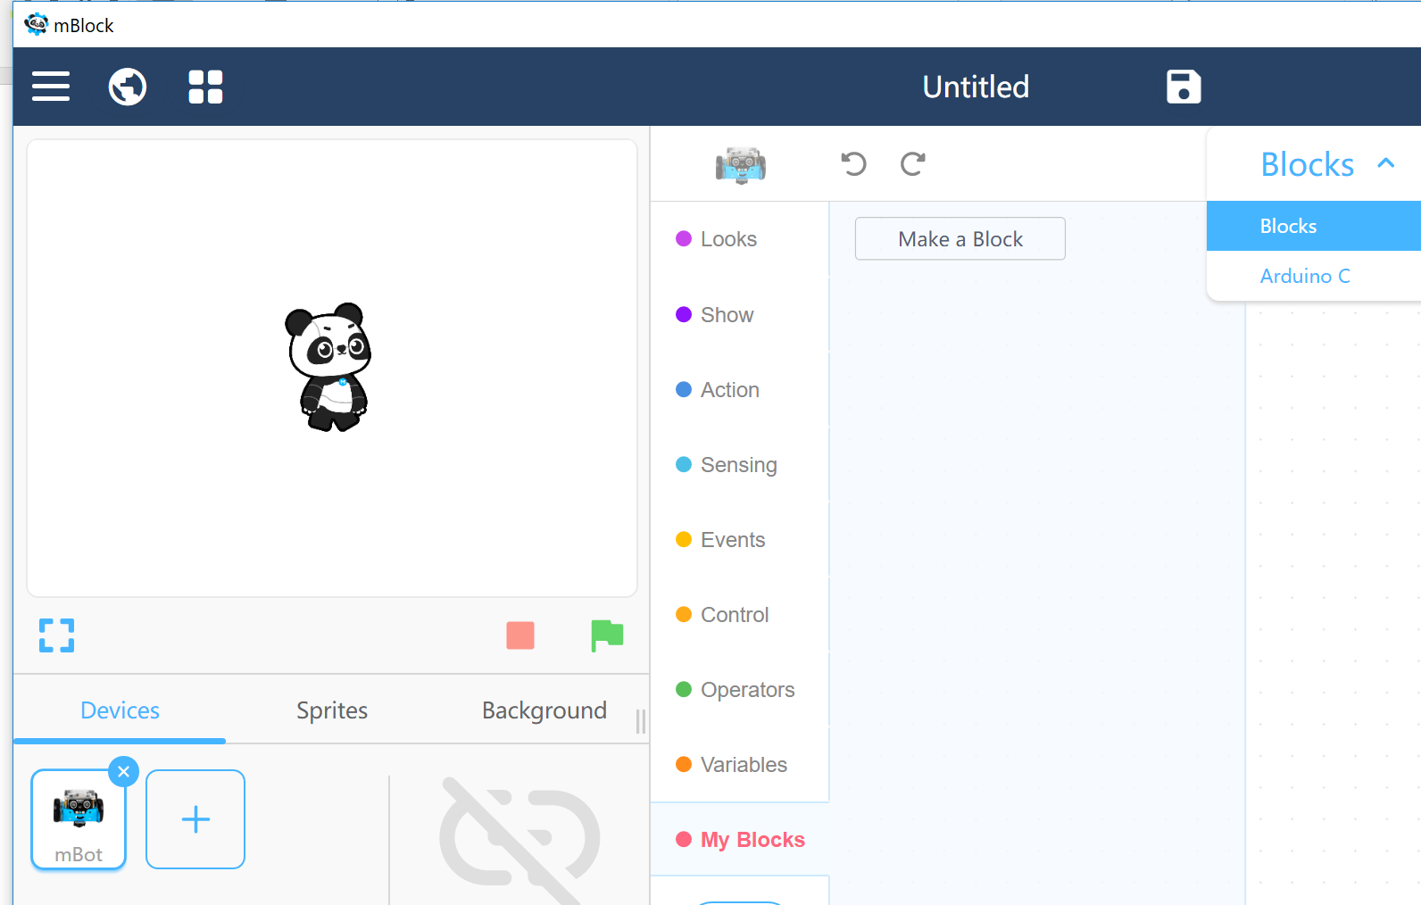
mBlock Environment
Blocks => text capability
Nice environment for loading in their sensors
Very Scratch-like with ability to move right into Arduino C

Slide 18
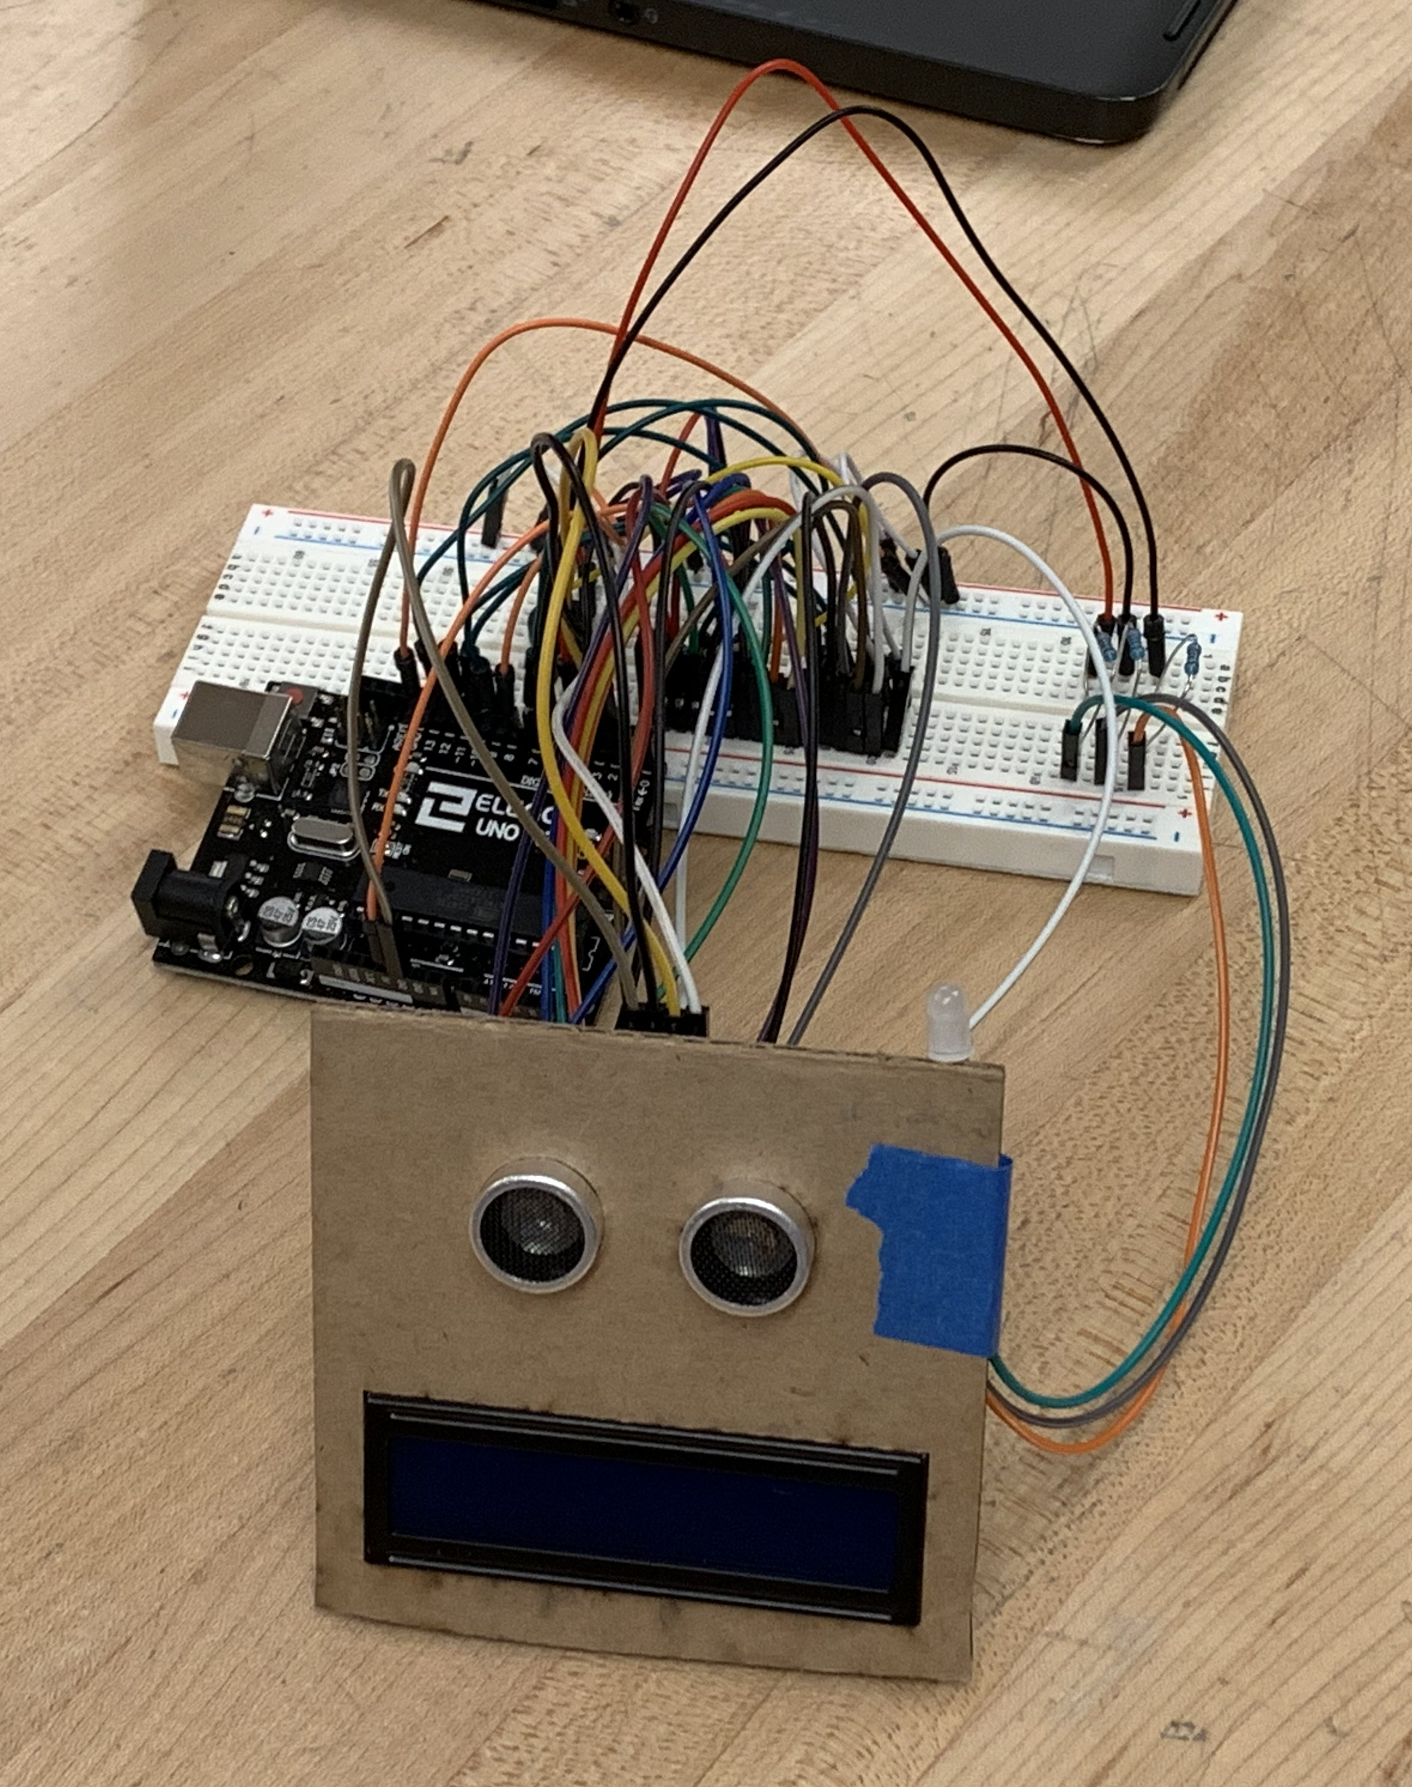
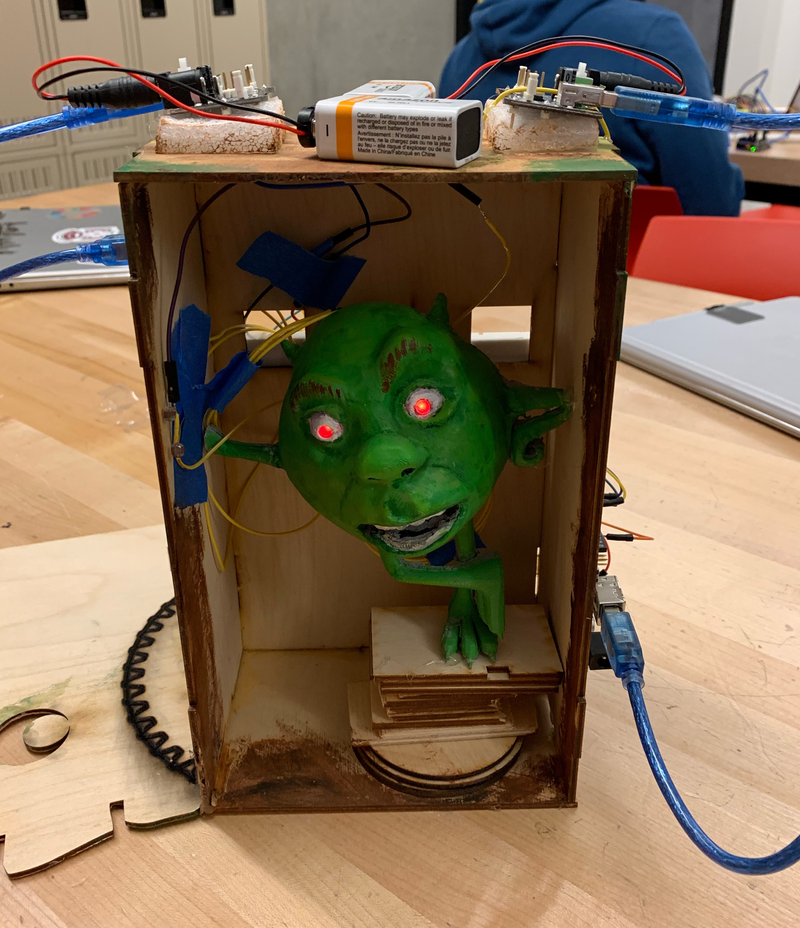
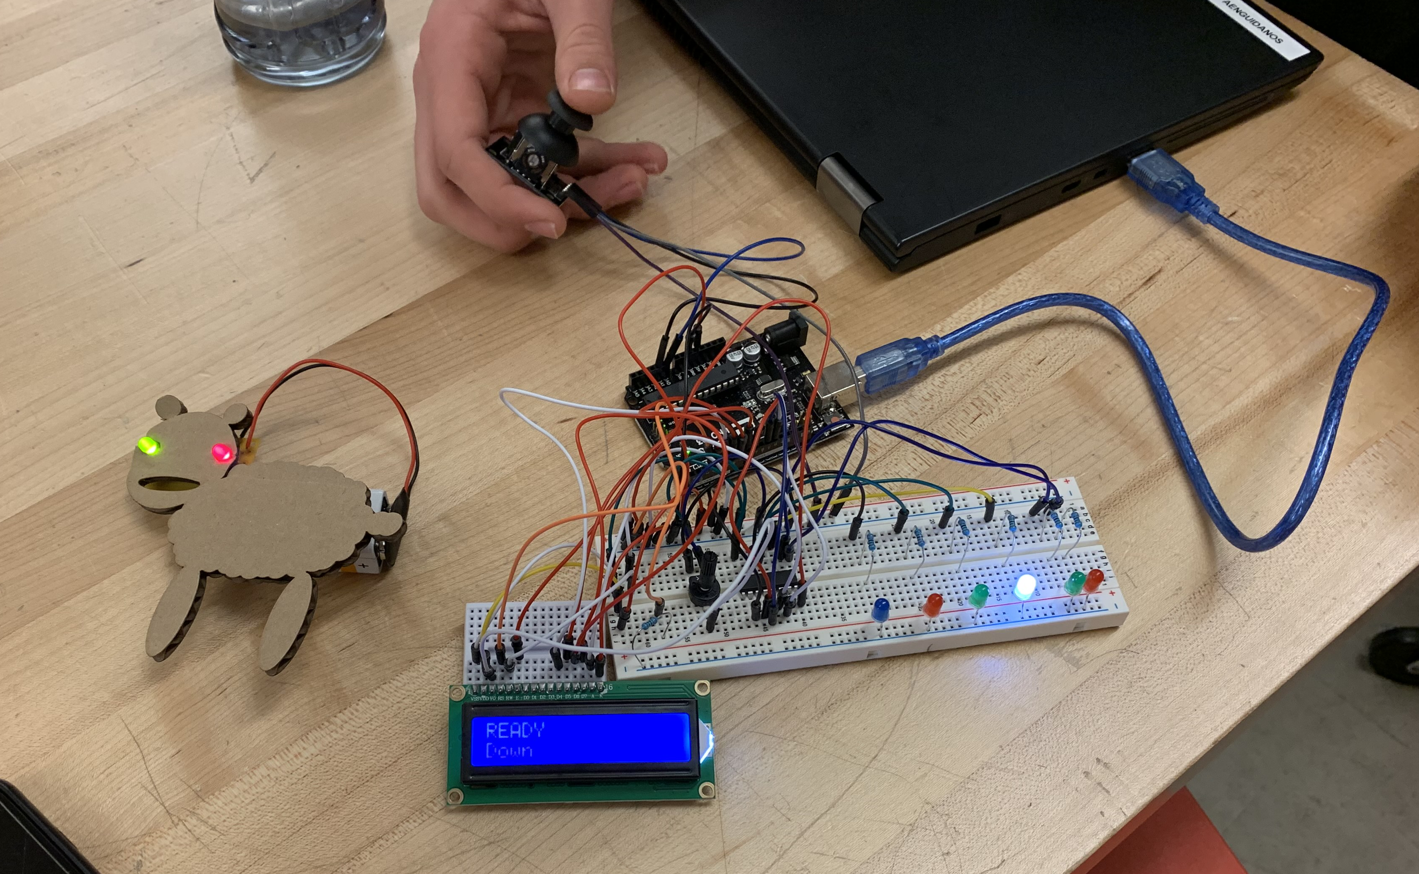
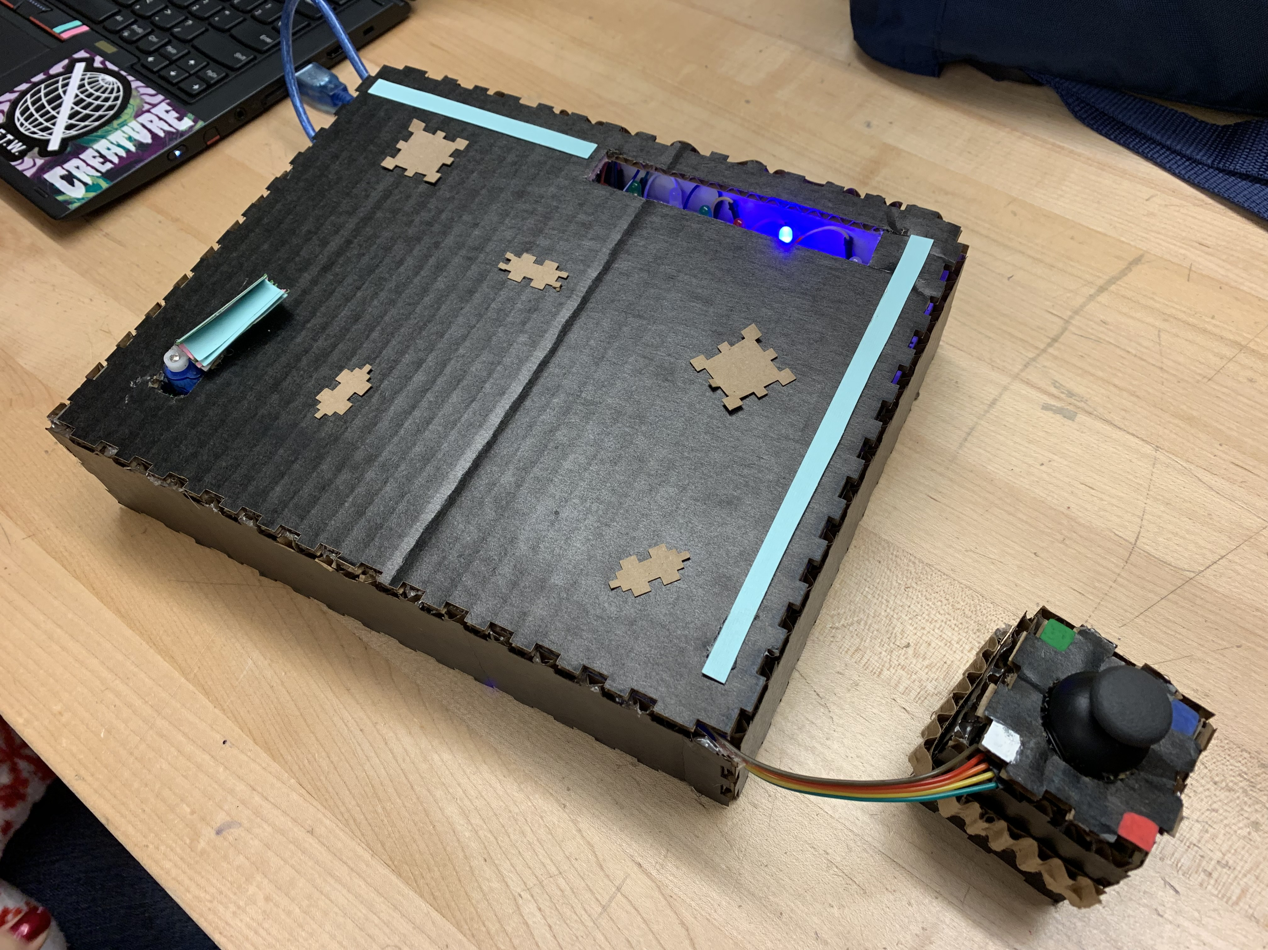
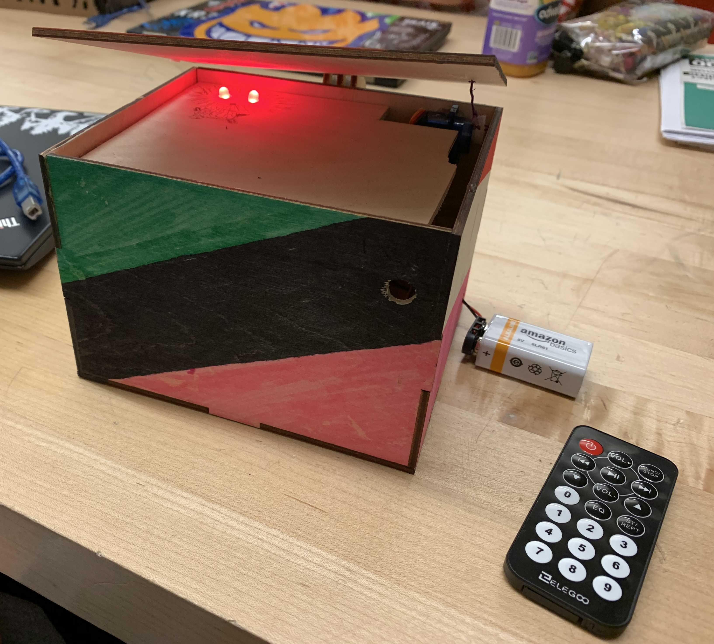
Upper/High School Class
Looking to broaden the scope from the middle school course
Focus on modularity and abstraction
Included other makerspace tools as well

Slide 19
All programs and devices are…
INPUT
PROCESSING
OUTPUT
+ STATE / CONTEXT **
** If there is any way to avoid keeping state, avoid it

Slide 20
INPUTS ARE… Sensors
INPUT
Buttons
Light
Sound
Temp
Humitity
Lightening
Magnetic
Compass
GPS
pH
IR (Remote)
Blutooth
Dials (pots.)
Bend sensor
RFID
Finger Print
Camera
Keyboard
Mouse
Etc.
Etc.

Slide 21
Processing is… logic and math
PROCESSING
  + STATE / CONTEXT **
Taking Sensor Data and Making it more meaningful (Abstract)
Electrical signals => intent
If you are tracking state, that is another input
Build a flow chart, track each decision
Turn the flow chart into blocks or code
0th rule of programming: The first 80% of the project takes 80% of the time. The last 20% takes the other 80% of the time.
** If there is any way to avoid keeping state, avoid it

Slide 22
Outputs are what your device “Does”
OUTPUT
Lights
Sound
Motors
Servos
Screens
Relays
Pumps
Heating
Cooling
Communication
Printing
3D Printing
Laser Cutting
CNC
Tweeting
Emailing
Etc.
Etc.

Slide 23
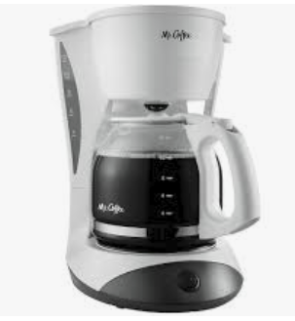
Example: Simple Coffee Machine
Inputs
  On button
  Thermometer
State
  Auto-off timer count
Processing
  If temperature is higher than boiling
    And auto-off timer is below 2 hours
      Turn off heater
  Else
    Keep heater on and check again
Output
  Electricity to heating coil
* Adding a variable auto-off time
  Adds an input (value of auto off button)
  Adds complexity to the Processing
  Output is the same
GOAL: Demystification!

Slide 24


TOOLS
TinkerCAD
Bootcamps
Iteration
Augmenting recipe + requiring Input => Processing => Output analysis
Arduino Project HUB
The WEB is your friend

Slide 25
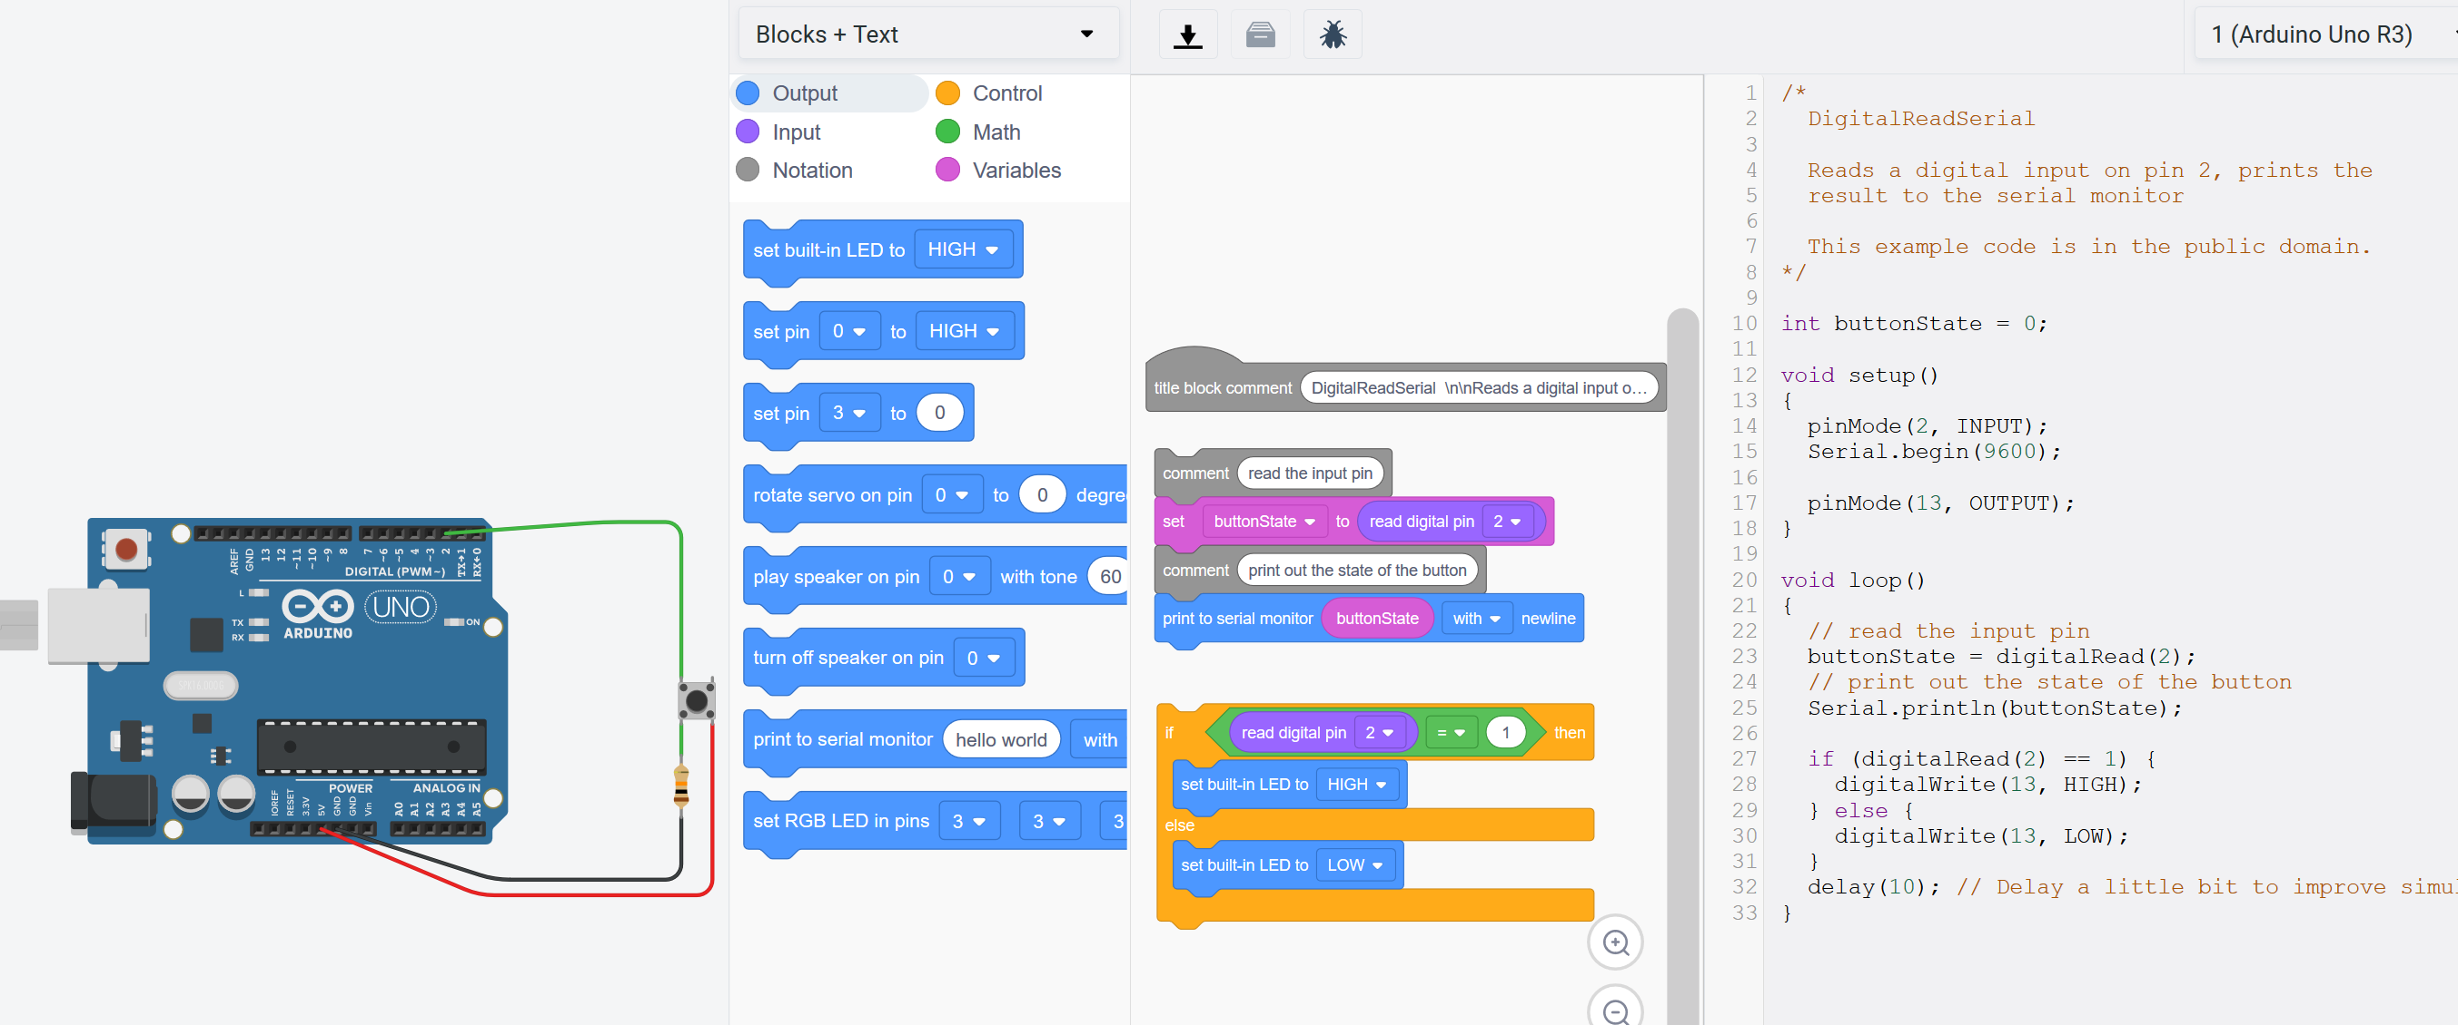
TinkerCAD Circuits (AND IT SIMULATES!)

Slide 26
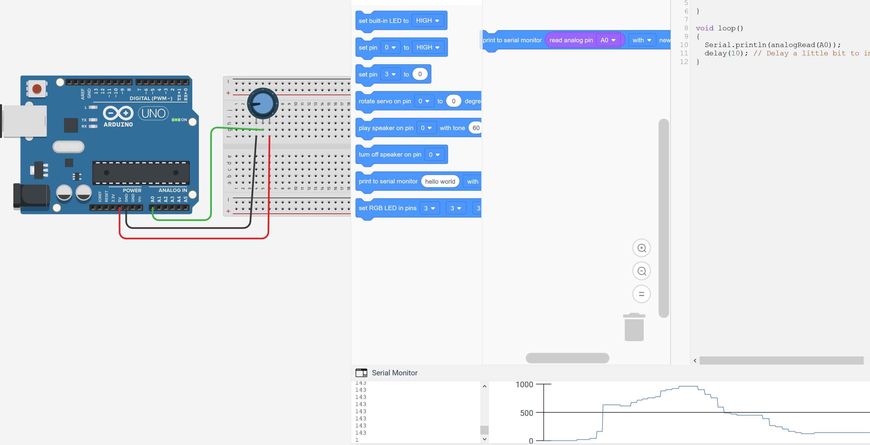
SERIAL MONITOR
Voltage Divider circuit is required for many sensors.
Do it on TinkerCAD, then in real life

Slide 27
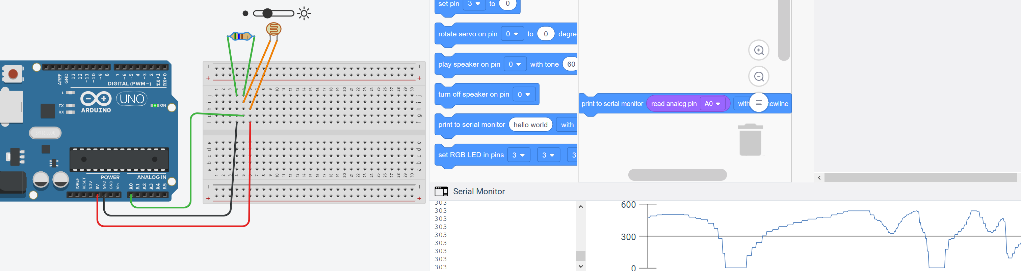
Don’t need the math yet – just build and monitor
Do it in the simulator to get close
Do it with real components and monitor using Serial.println(val);
  All you need to do is get clear signals above the noise

Slide 28
Bootcamps: Get the skills fast in the first week
Laser Cutting
Soldering
Component identification in real life, on schematics, color codes
Software environment up to modify the blink program into an SOS light

Slide 29
LAB Projects: Low Entry, High Ceiling
Minimum product
  Elegoo or EPS created Lab
  Layering on Input => Processing => Output
Differentiation
  What else would you like your device to do?
  What do you really mean by “press the button”?
  Can you swap out an input?
  Can you make the same physical device do something different via processing?
  Can you take the same inputs and processing but swap outputs for a different effect?

Slide 30
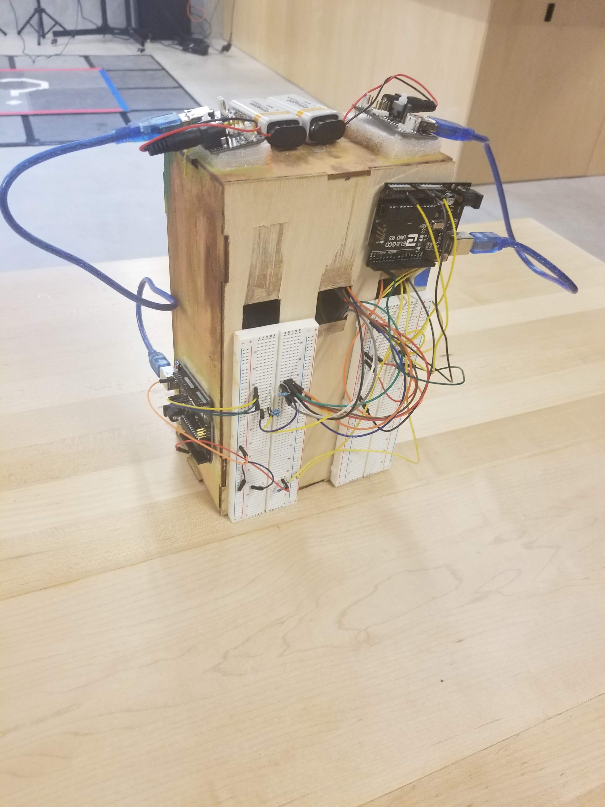
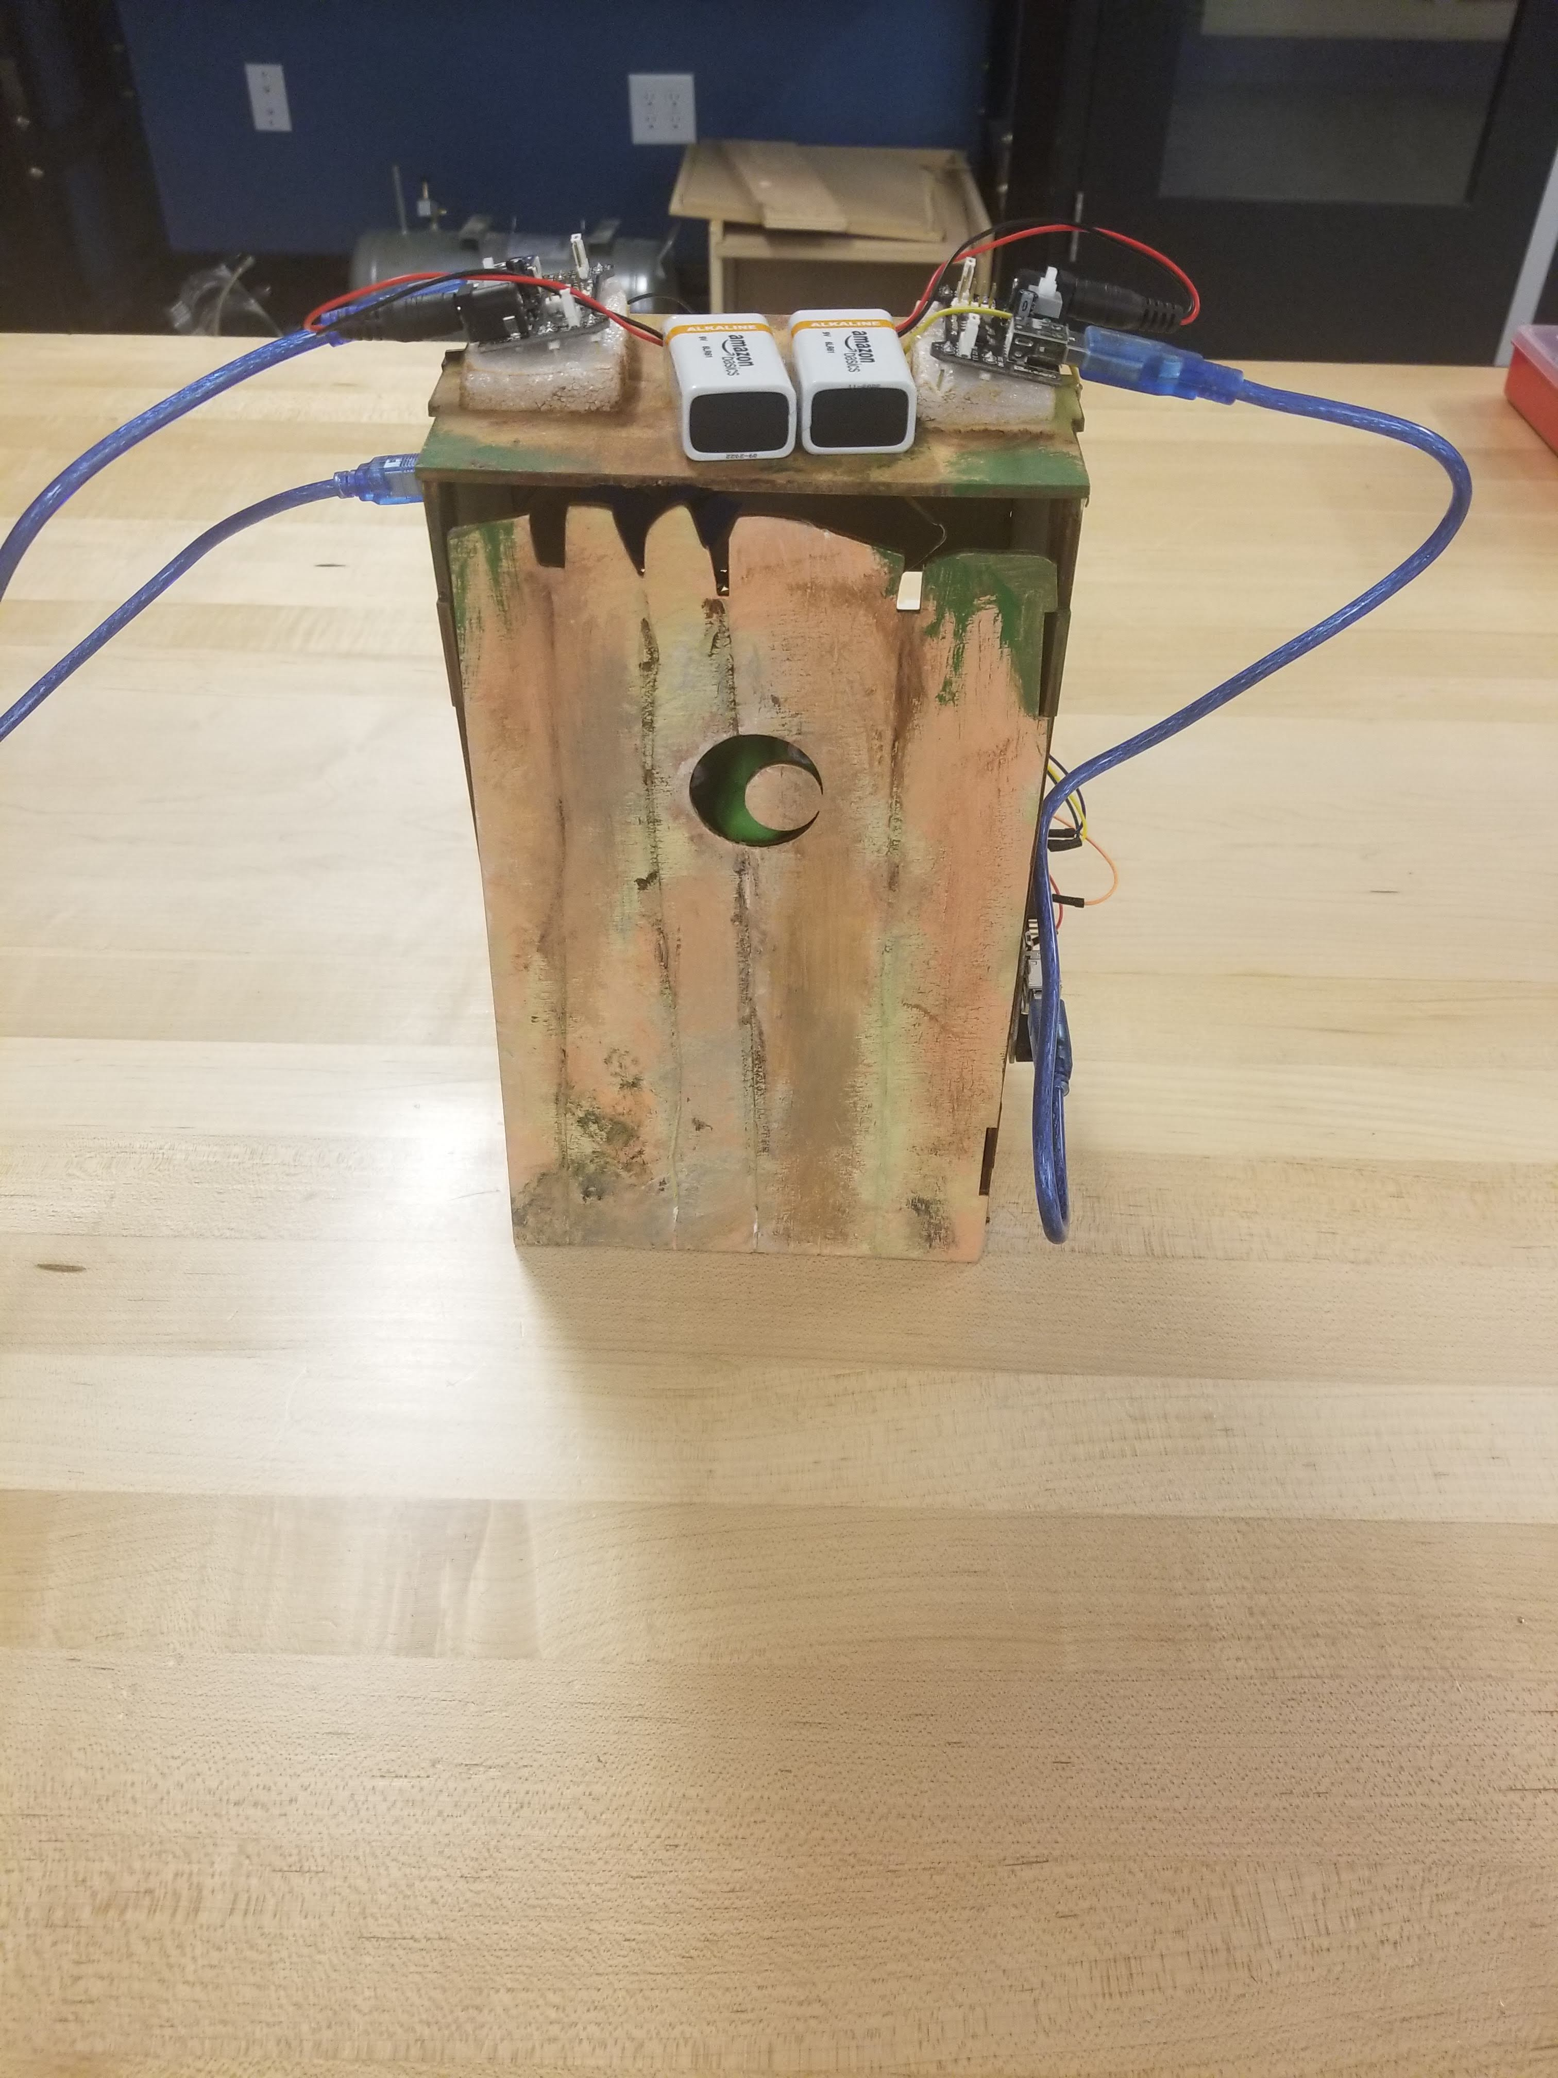
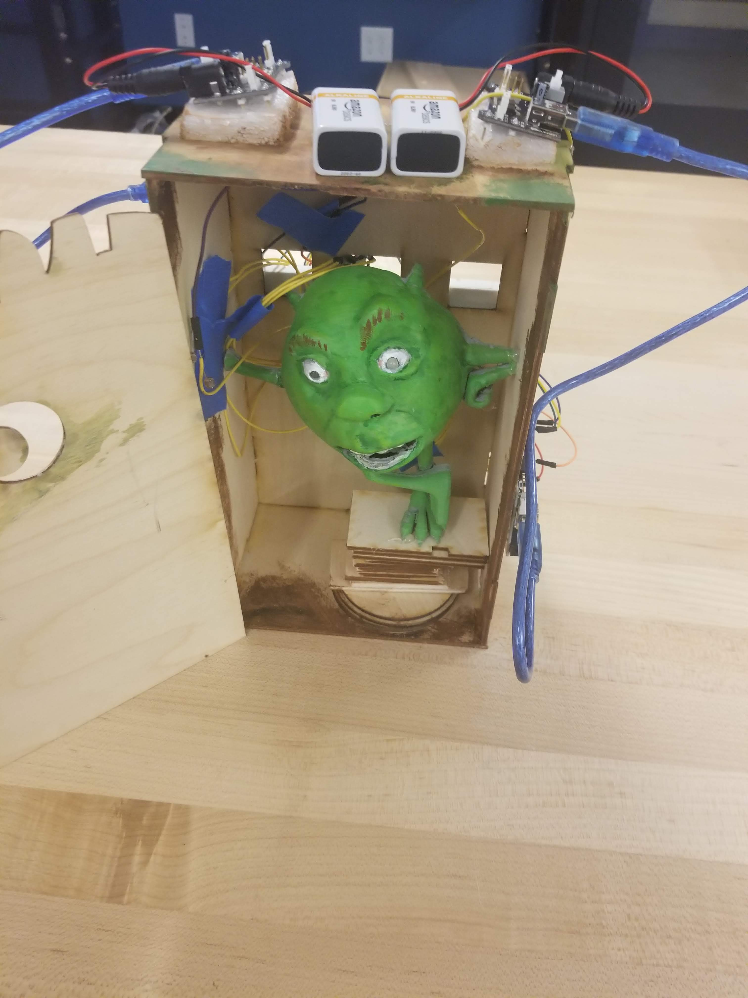
Final Project: Build a device that elicits an emotion
Success is built on prototyping, iteration and user feedback
All resources are fair game
In practice, we help a lot with the processing
Some solutions are surprising

Slide 31
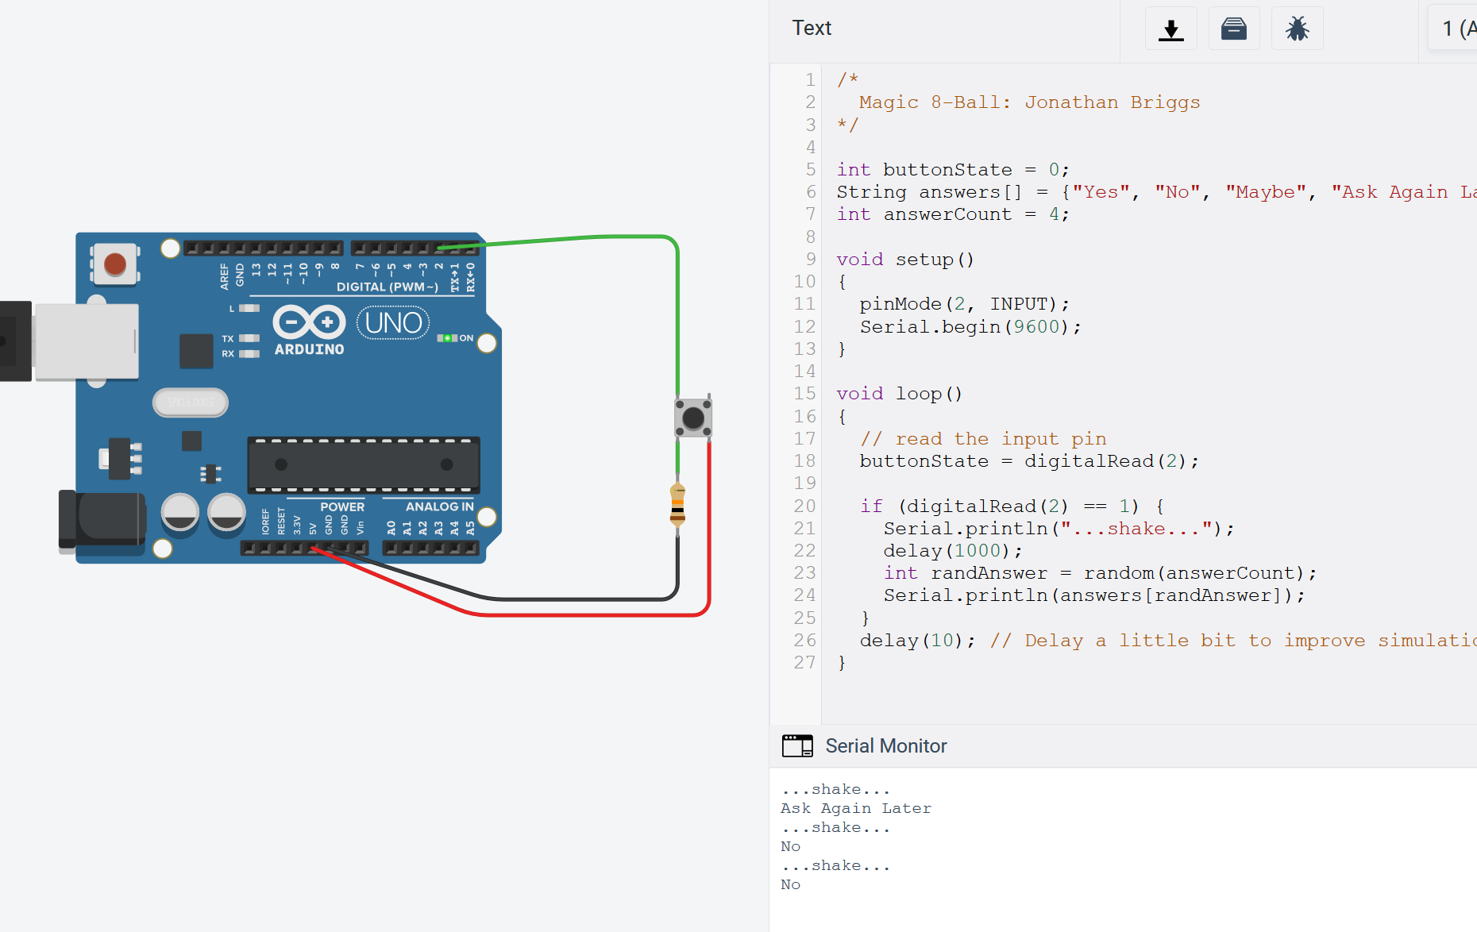
Example: Magic 8-Ball, Power, Differentiation
Idea: Magic 8ball
  Simplest thing that will work
    Input: Button
    Processing
      Arrays of strings
      Random Number
    Output
      Serial.println(answers[random]);

Slide 32
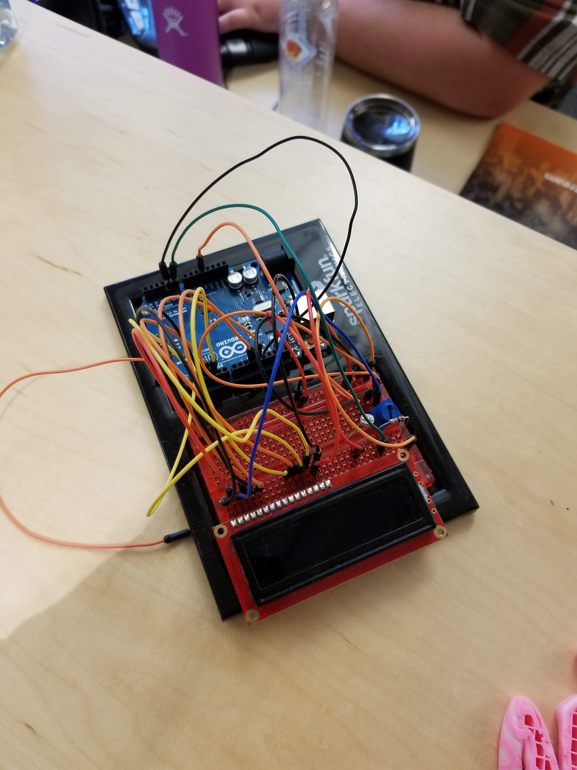
Magic 8-Ball
Output to LCD screen [OUTPUT]
Trigger on clap, ultrasonic sensor, bend sensor, touch sensor [INPUT]
Add more/custom answers [PROCESSING]
Add positive and negative answer banks, use a secret input to get the answer you want from the 8-ball [INPUT & PROCESSING]
Output to LEDs, Neopixels, Recorded voices [OUTPUT]
Build an elegant outer skin/container to hold your device [DESIGN]
Add some “thinking” indicator to increase suspense [OUTPUT & PROCESSING]

Slide 33
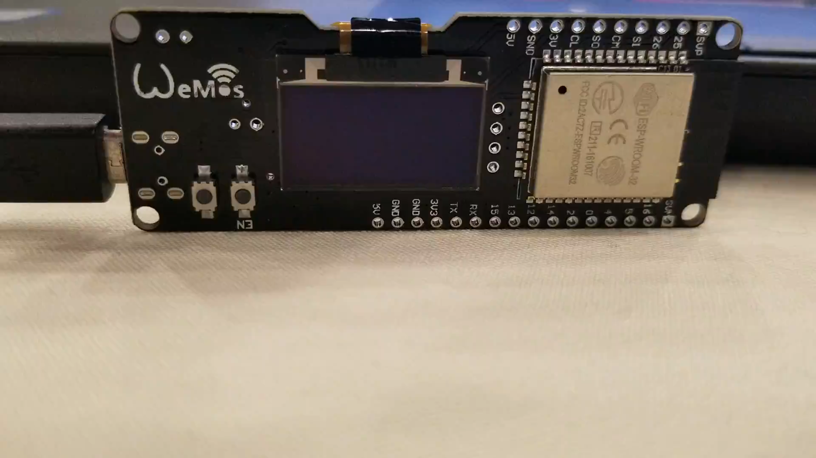
Getting Silly
WiFi Provisionable
Wireless
Web Server
Animated
Remote triggerable
Noise Filtering
Secretly Force Yes Answers
…
And you could still do more with it…

Slide 34
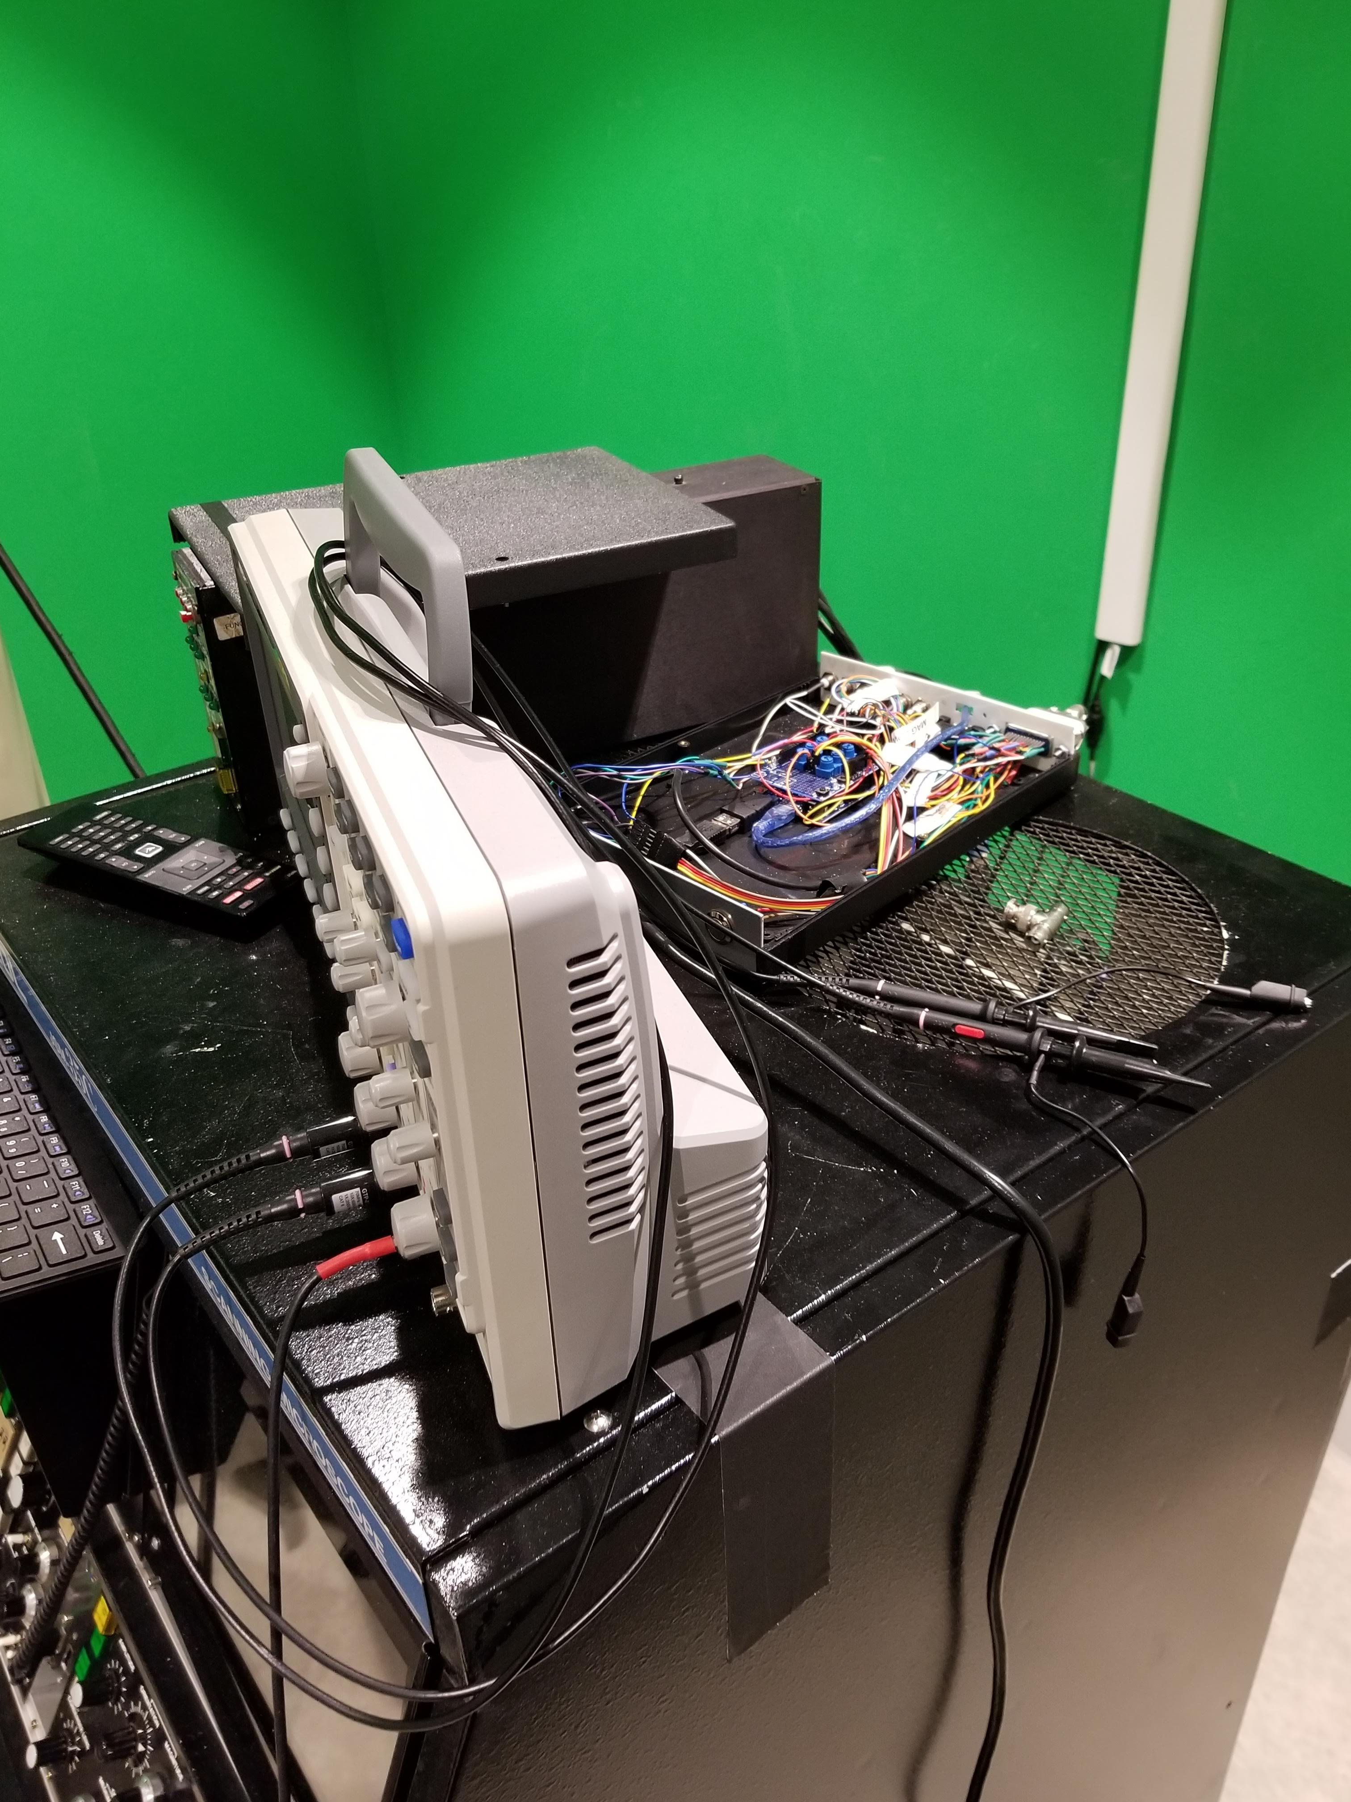
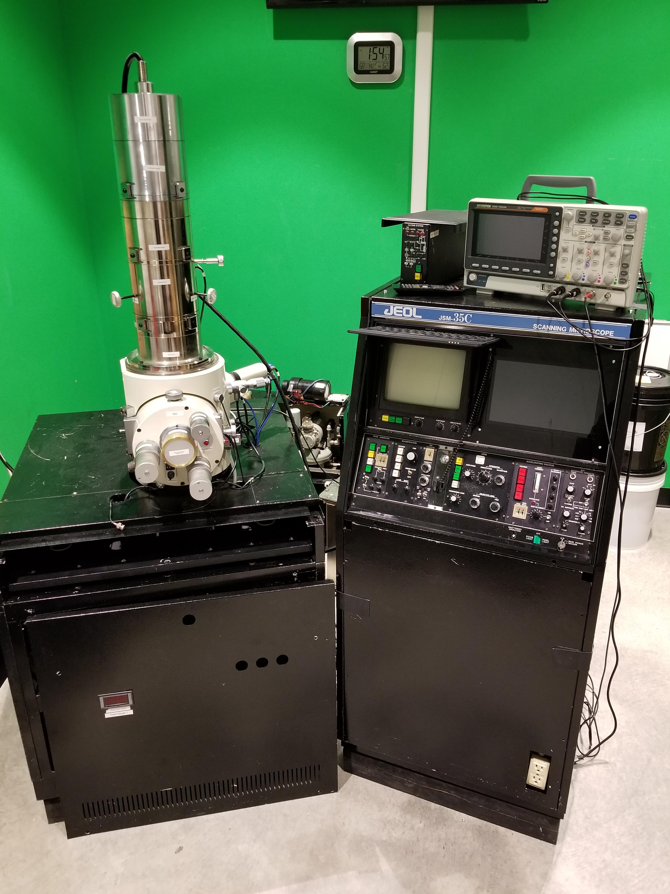
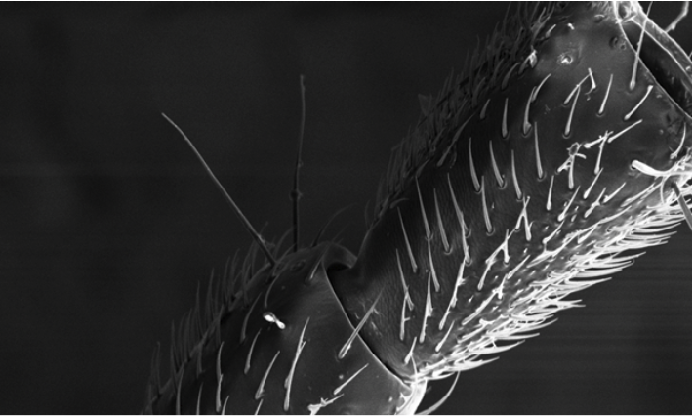
Show the Ceiling: Faculty Projects
Digitizing a 1978 Scanning Electron Microscope
Coming soon: Car Computer
http://si.madeateps.org/

Slide 35
Thank you! Questions?
Interested in a wealth of resources?
For the next 6 days there’s a humble bundle from O’Reilly
https://www.humblebundle.com/books/microcontrollers-books
14 Books, 2 Magazines for $18 in PDF/ebook form
($1 even gets you a few)
Jonathan Briggs
Chief Technology & Innovation Officer
Eastside Preparatory School
Kirkland, WA
jbriggs@eastsideprep.org
@gotphysics
Today’s slides and other presentations at https://bit.ly/BriggsNCCE
Want to teach some of what you saw here? We’re hiring for this class right now http://www.eastsideprep.org/who-we-are/employment/

