Slide 1


Building an innovative educational environment
Jonathan Briggs, Director of Strategy, Technology & Innovation
Eastside Preparatory School
GIX Summit 2019-11-02

Slide 2

Educational Objective:
Prepare students for the future
Thought Experiment:
Imagine we had perfect future prediction ability in 2009
What would we have built in 2009 to prepare students for their careers in 10 years?
What would we have taught them?

Slide 3
Constraint: The technical capability of 2009
The world compared to 10 years ago, some examples
  Processing power has increased 900%
  Storage capacity has increased 1,500%
  Digital voice assistance usage 0% 46%
  Smartphone usage 16% 81%
    Mobile internet speeds 3.1 MBPS 1,300 MBPS
  Electric Cars Sold (US) 2008-10: 4,700 2018: 361,000
Notes:
Smartphone usage 2009 https://www.nielsen.com/us/en/insights/article/2009/with-smartphone-adoption-on-the-rise-opportunity-for-marketers-is-calling/
Smartphone usage 2019 https://www.pewresearch.org/internet/fact-sheet/mobile/

Slide 4
Conclusion: It is not possible to directly prepare students for the future
The world is changing faster and faster. The target isn’t clear.
Today’s technical skills will be outdated many times over
Tools today are not powerful enough to do what is needed for tomorrow.
Many skills employers are looking for are recently invented or recently possible.

Slide 5
Example, Student Objective:
To be a Web Application Developer after College
Graduating College in 2019, means we would have been building curriculum in 2009 for…
Web Developer Skills needed today
  HTML5, released 2014
  React Framework, in moderate use by 2016
  Node.js and npm, 2010
  Microservices architecture, on the radar 2016
  Websockets, released 2011
  Webpack, 1.0 in 2014
  Github, started in 2008
  Cloud virtual machines, released 2006
All of the above are also many versions beyond where they started
It is not possible to have prepared a student with the skills needed to succeed in that career in high school.

Slide 6


It is even worse than that…
Many great jobs of today didn’t exist in 2009 either. There was no way to prepare a student for them.
Data scientist
Self-driving car engineer
Artificial Intelligence specialist
Machine Learning Specialist
Mobile App Developer
Social Media Manager
Cloud Architect
DevOps
Search Engine Optimization
Tech Ethicist
User Experience Designer
Drone Operator or Programmer
Quantum Computer Programmer
Blockchain contract programmer

Slide 7
Your objective as a school is still to prepare students for their futures
There is a solution!
As a high school, you can prepare for college
  Preparation for college is known – knowledge about those academic subjects can jumpstart success.
  Student self-advocacy pays dividends
Teach to the timeless. What does not change?
Adult culture matters, students will emulate what the observe
You must equip students with the tools to understand and thrive in the future when they get there

Slide 8
Aside: Innovation is not scripted, it happens with the right environment
Belief in human progress
Diverse ways of thinking engage with each other
  Product
  Design
  Engineering
  Promotion
There is a worthwhile problem to solve
There are tools and resources available
When domains of expertise are joined
  Bio-tech
  Data Science
  Physical Chemistry
  Biomimicry

Slide 9

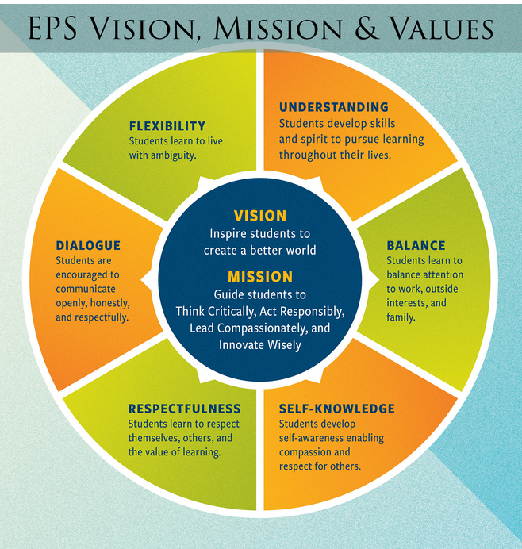
Eastside Prep Environment
Supporting Culture
High Trust environment
Diverse ways of thinking
Relationship based
Frequent feedback
Choice & Agency
Constantly evolving

Slide 10
Your objective as a school is still to prepare students for their futures
There is a solution!
As a high school, you can prepare for college
  Preparation for college is known – knowledge about those academic subjects can jumpstart success.
  Student self-advocacy pays dividends
Teach to the timeless. What does not change?
Adult culture matters, students will emulate what the observe
You must equip students with the tools to understand and thrive in the future when they get there

Slide 11
Success for students has always required:
Working with diverse teams of people
Learning new things
Assessing your environment
Breaking large problems and projects into smaller ones
Commitment to long term projects
Exposure to cutting edge technology
Communication
Moving from problem admiration to problem solving
Leveraging and deepening each student’s interests

Slide 12

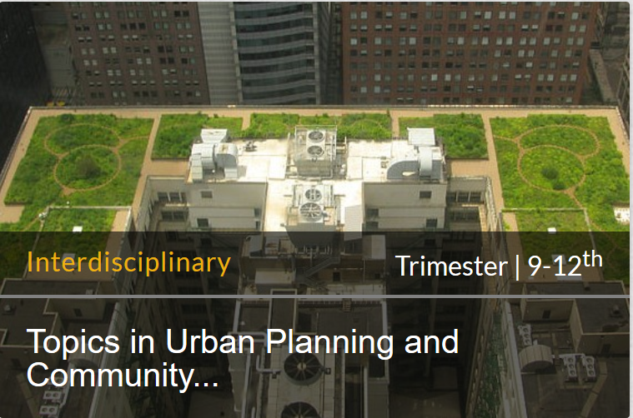
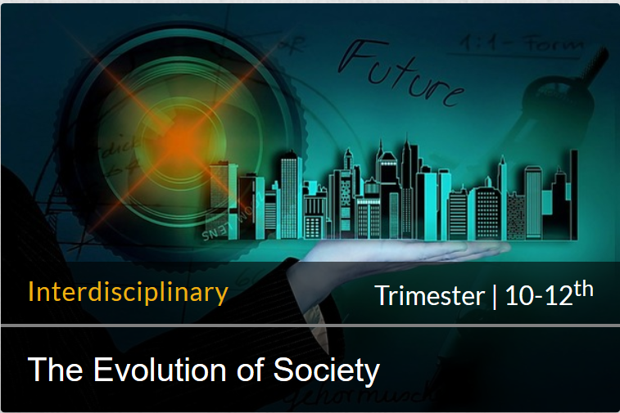
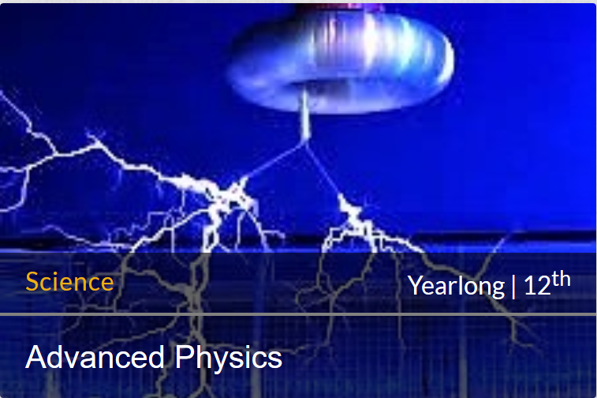
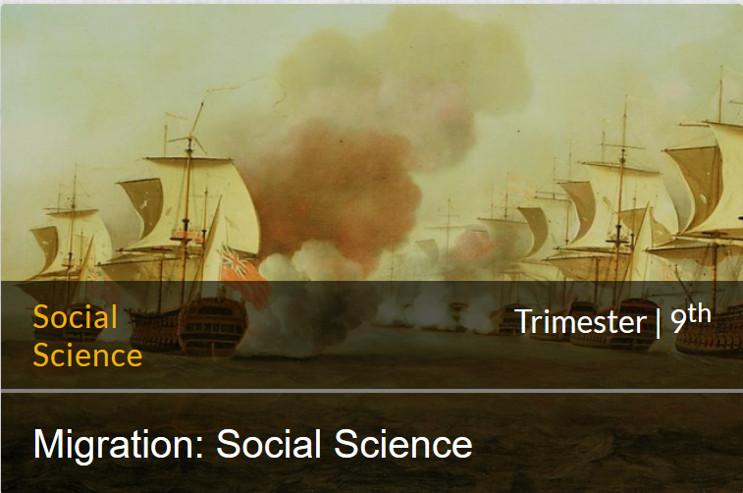
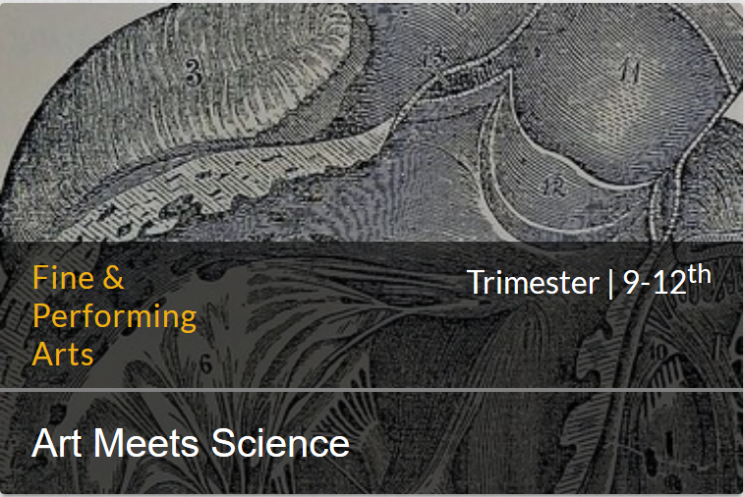
Eastside Prep Example: Pedagogical Posture
Diversity in ways of thinking
Human Progress
Agency and Choice
Working with diverse teams of people
Learning new things
Assessing your environment
Breaking large problems and projects into smaller ones
Commitment to long term projects
Exposure to cutting edge technology
Communication
Moving from problem admiration to problem solving
Leveraging and deepening each student’s interests

Slide 13
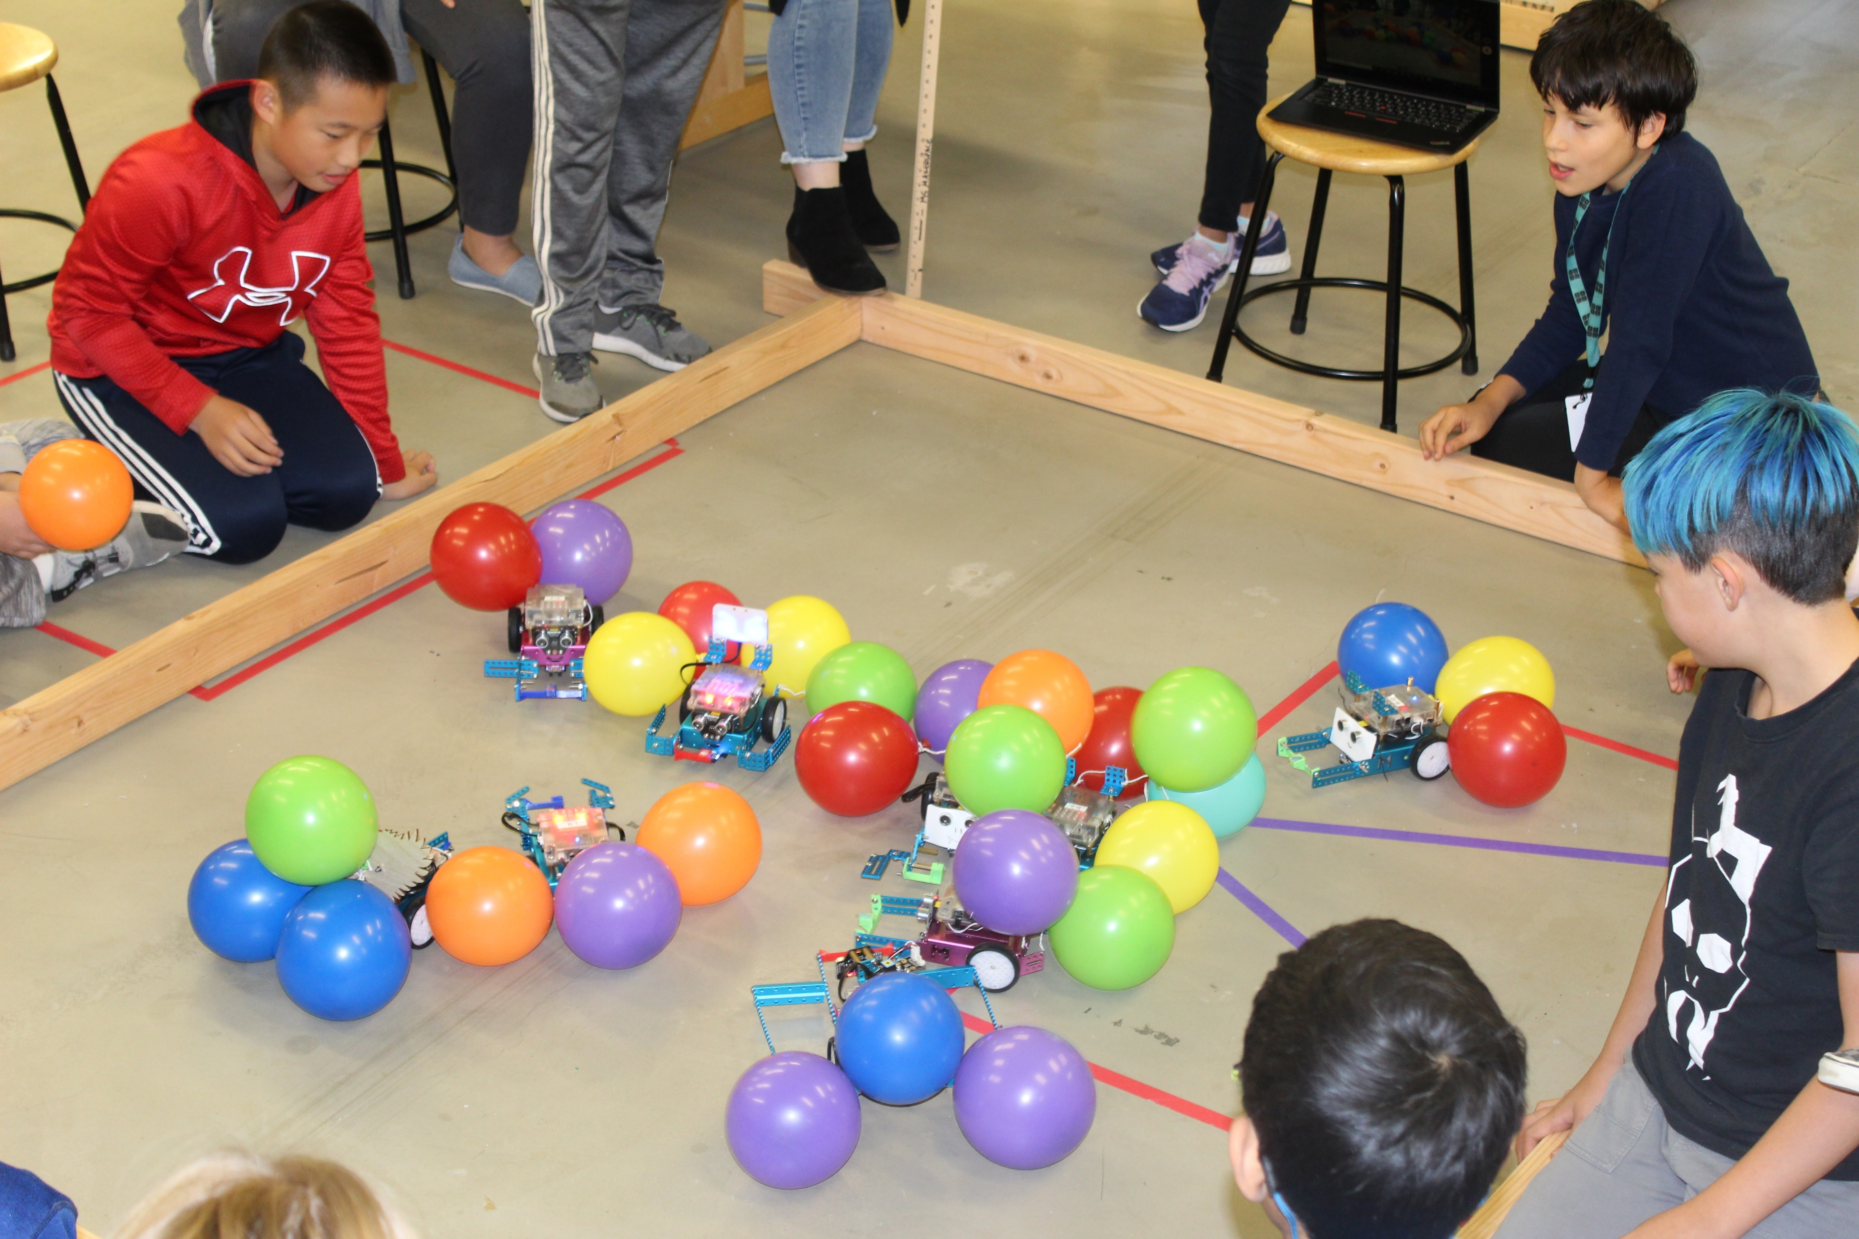
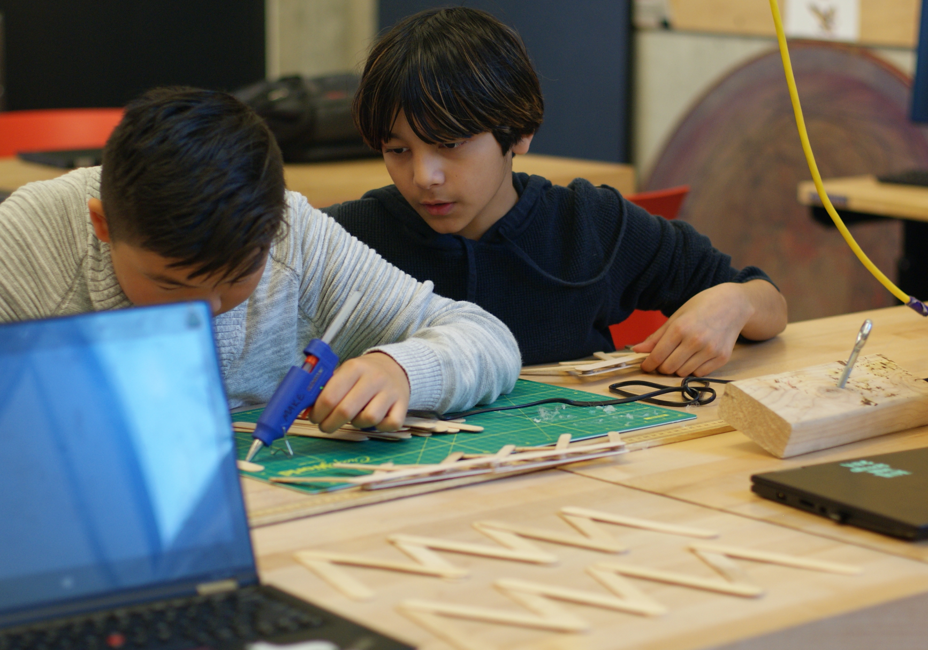
Eastside Prep Example: Open Makerspace
Build your ideas
Foster creativity
Reinforce the value of iteration
Working with diverse teams of people
Learning new things
Assessing your environment
Breaking large problems and projects into smaller ones
Commitment to long term projects
Exposure to cutting edge technology
Communication
Moving from problem admiration to problem solving
Leveraging and deepening each student’s interests

Slide 14
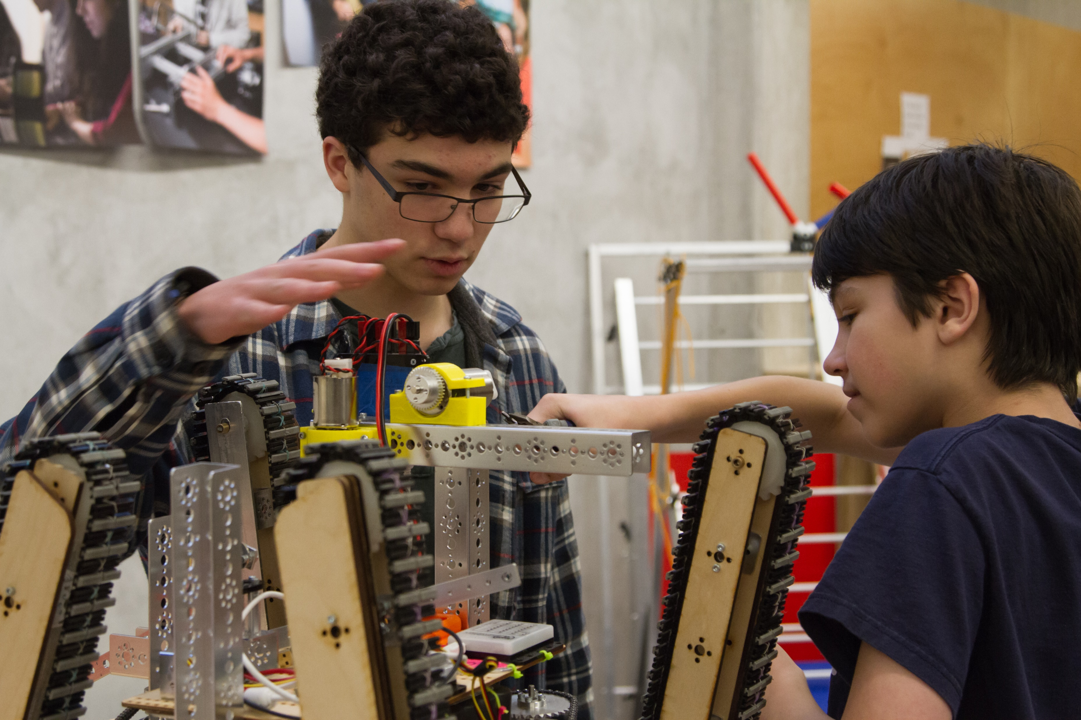
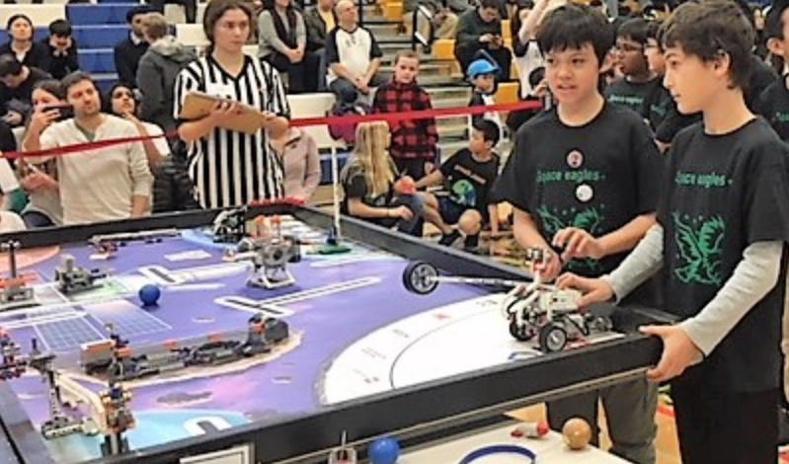
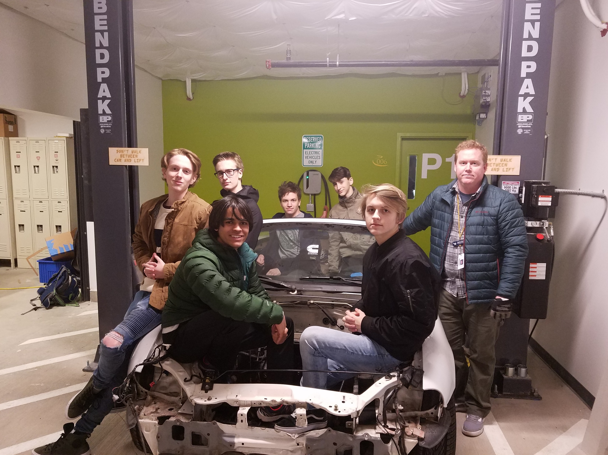
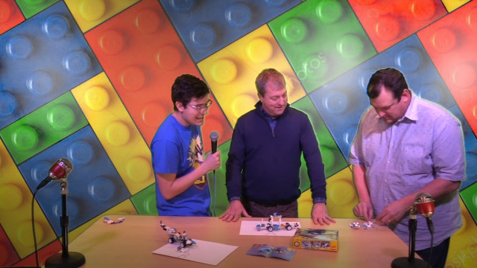
Eastside Prep Example: Academic Teams
Working with diverse teams of people
Learning new things
Assessing your environment
Breaking large problems and projects into smaller ones
Commitment to long term projects
Exposure to cutting edge technology
Communication
Moving from problem admiration to problem solving
Leveraging and deepening each student’s interests
Middle School Robotics
Upper School Robotics
Fusor Project
Electric Car Conversion
Broadcast Club
Debate Team
Math Team

Slide 15


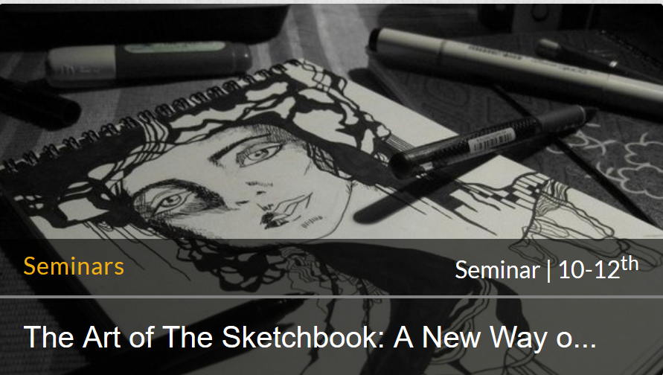



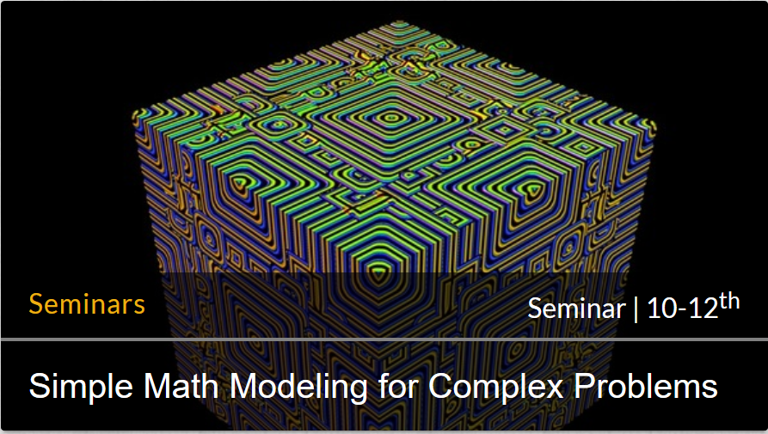
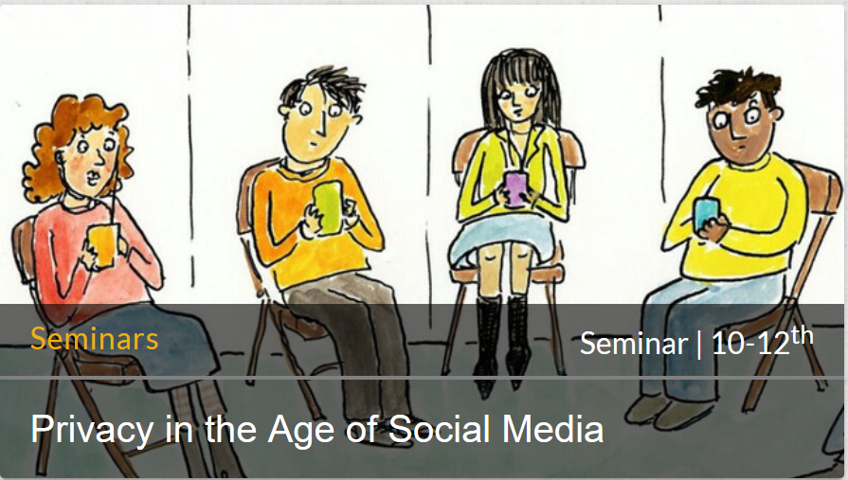
Eastside Prep Example: Seminars
Introduction to the independent curriculum
Six meetings with six students and one to two faculty members. Once a week for one hour.
Working with diverse teams of people
Learning new things
Assessing your environment
Breaking large problems and projects into smaller ones
Commitment to long term projects
Exposure to cutting edge technology
Communication
Moving from problem admiration to problem solving
Leveraging and deepening each student’s interests

Slide 16

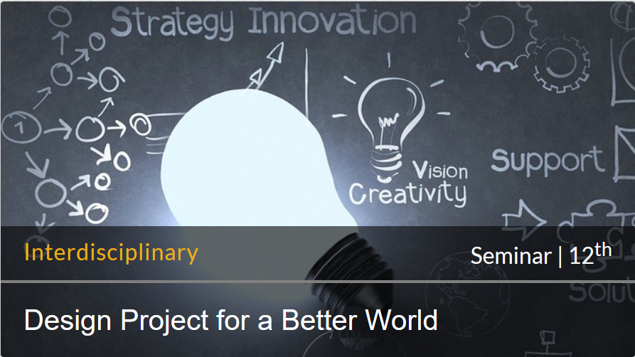
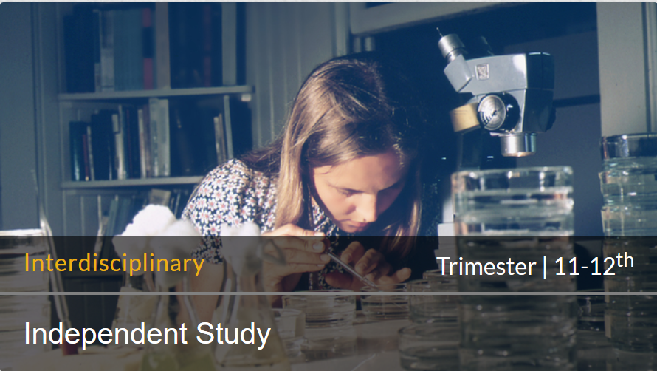
Eastside Prep Example: Independent Curriculum
Working with diverse teams of people
Learning new things
Assessing your environment
Breaking large problems and projects into smaller ones
Commitment to long term projects
Communication
Moving from problem admiration to problem solving
Leveraging and deepening each student’s interests
Exposure to cutting edge technology
Independent Study
Machine Learning, Crime and Public Policy, Climate Crisis, Algorithms in Genome Sequencing, …
Senior Thesis
Immunotherapy in Cancer Treatment
Behavioral Economics
Senior Project
Electric bicycle build,
writing a novel, voting security,
producing an album,
building a business, mobile app,
video game design and build

Slide 17
Your objective as a school is to prepare students for their future
Your objective is to: Engage and empower students to solve problems with the tools available.
“We coexist in a state of future anticipation that cannot be predicted but for which we claim (or are expected) to be preparing our students”
– Terry Macaluso, PhD, Head of School, Eastside Preparatory School (NAIS Magazine, Spring 2018)
You must equip students with the tools to understand and thrive in the future when they get there
Only students can prepare themselves for their futures
  Success comes from reacting to your environment not having the right answer

Slide 18
Thank you
Jonathan Briggs
Director of Strategy, Technology & Innovation
Eastside Preparatory School
Kirkland, WA
jbriggs@eastsideprep.org

